Slide 1

String, StringBuilder, and Character classes
CMPS 251
Read Chapter 14
Unit 2-02

Slide 2
Outline
String class
StringBuilder class
Character class

Slide 3
Basic concepts
The Character, String, and StringBuilder classes are in the java.lang package.
A program may contain character literals.
An integer value represented as a character in single quotes.
The value of a character literal is the integer value of the character in the Unicode character set.
String literals (stored in memory as String objects) are written as a sequence of characters in double quotation marks.
CMPS 251 (Object-Oriented Programming), Mohammad Saleh, Spring 2015, CSE-CENG-QU

Slide 4
Class String constructors
No-argument constructor:
creates a String that contains no characters (i.e., the empty string, which can also be represented as "") and has a length of 0.
Constructor that takes a String object:
copies the argument into the new String.
Constructor that takes a char array:
creates a String containing a copy of the characters in the array.
Constructor that takes a char array and two integers:
creates a String containing the specified portion of the array.
CMPS 251 (Object-Oriented Programming), Mohammad Saleh, Spring 2015, CSE-CENG-QU

Slide 5
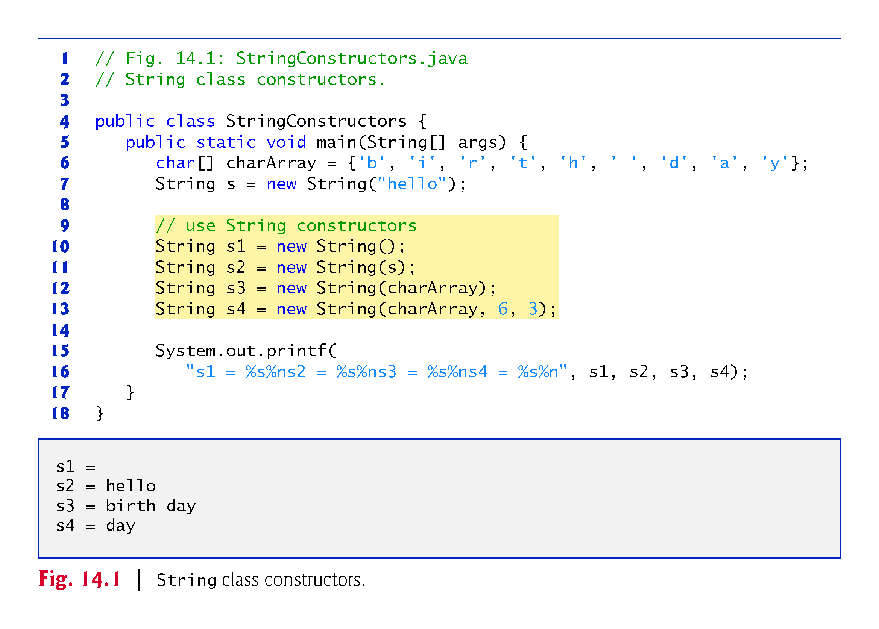

Slide 6
Important remarks
String objects are immutable.
Their character contents cannot be changed after they created.
Class String does not provide methods that allow the contents of a String object to be modified.
Accessing a character outside the bounds of a String ( index less than 0 or greater or equal to the length of the string) results in an exception:
StringIndexOutOfBoundException
CMPS 251 (Object-Oriented Programming), Mohammad Saleh, Spring 2015, CSE-CENG-QU

Slide 7
Methods of the class String
length: determines the number of characters in a string.
charAt: returns the character at a specific position in the String.
getChars: copies the characters of a String into a character array.
The first argument is the starting index in the String from which characters are to be copied.
The second argument is the index that is one past the last character to be copied from the String.
The third argument is the character array into which the characters are to be copied.
The last argument is the starting index where the copied characters are placed in the target character array.
CMPS 251 (Object-Oriented Programming), Mohammad Saleh, Spring 2015, CSE-CENG-QU

Slide 8
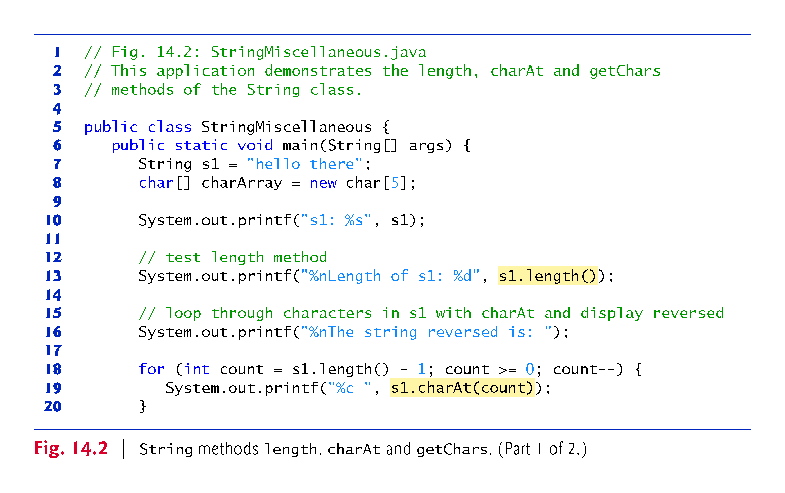

Slide 9
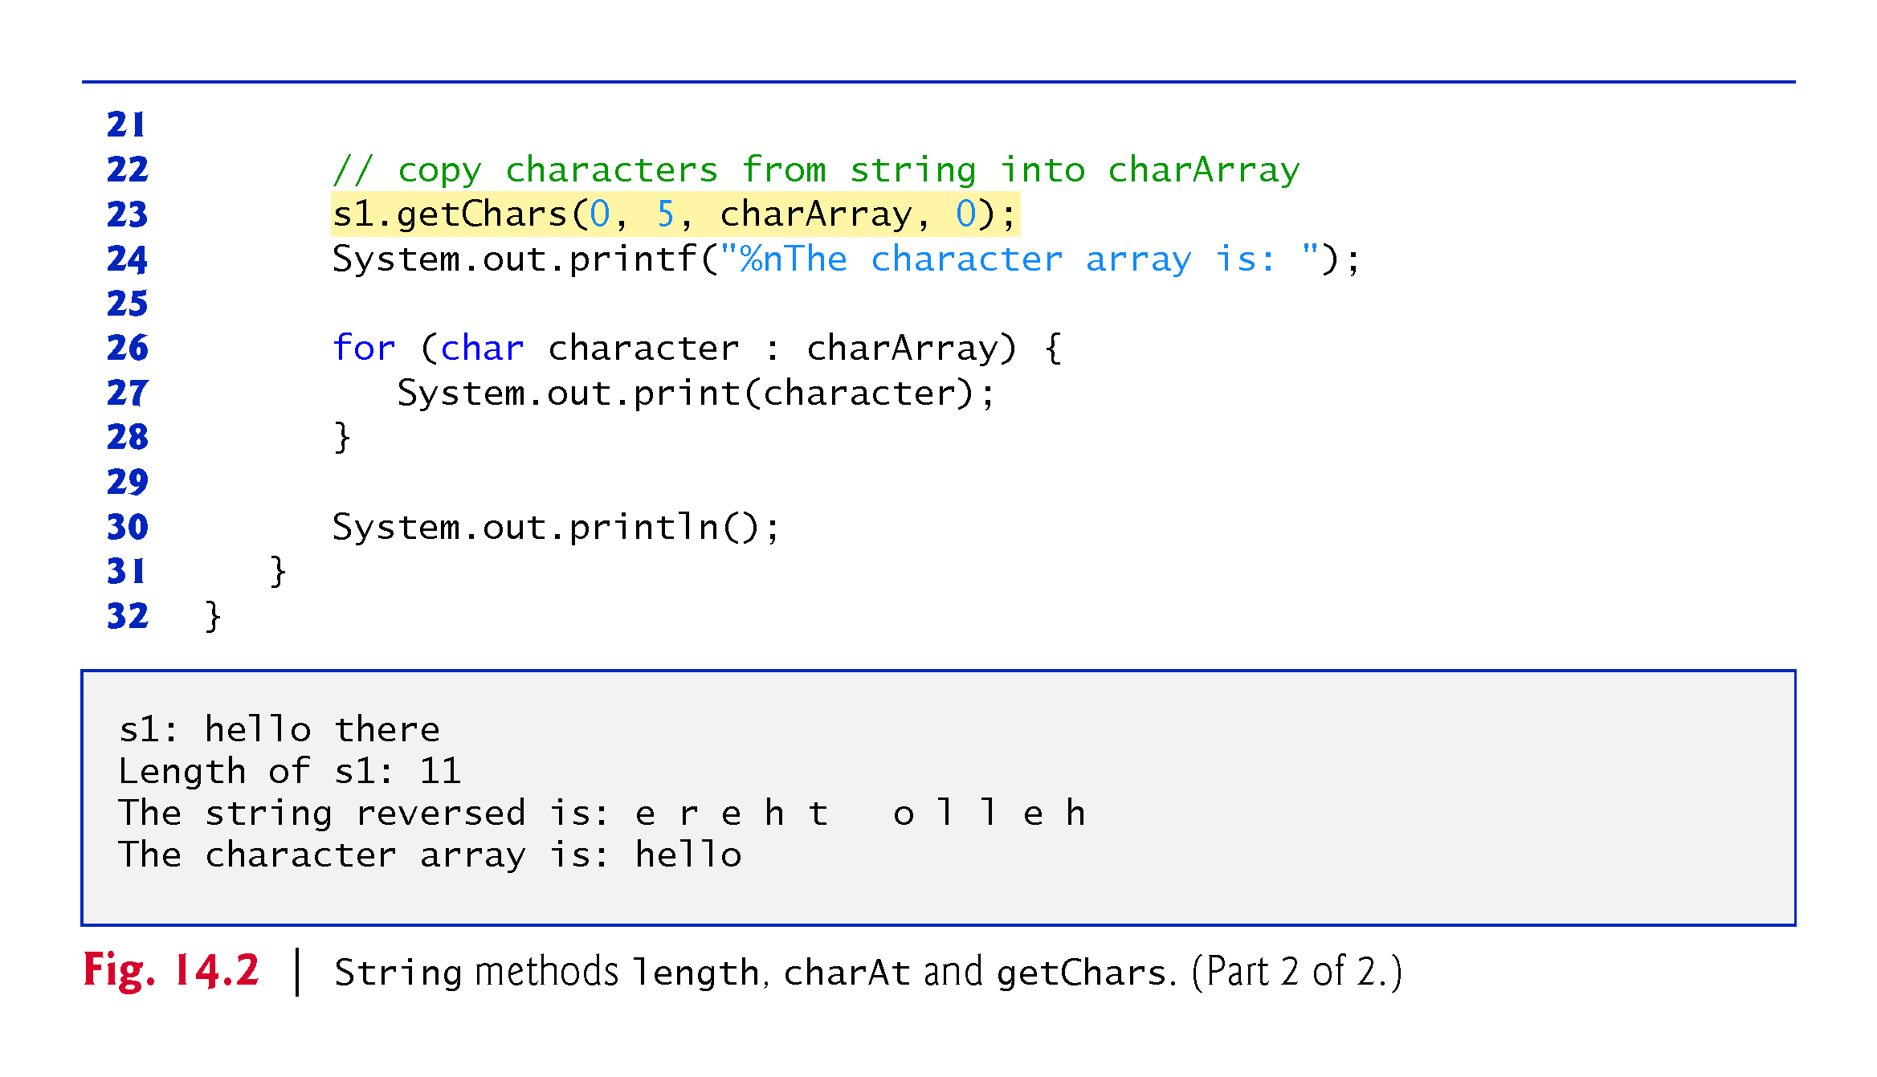

Slide 10
Comparing Strings
Strings are compared using the numeric codes of the characters in the strings.
Various comparisons
equals
equalsIgnoreCase
compareTo
regionMatches
using the equality operator == to compare String objects
CMPS 251 (Object-Oriented Programming), Mohammad Saleh, Spring 2015, CSE-CENG-QU

Slide 11
Comparing Strings
Method equals:
tests any two objects for equality
The method returns true if the contents of the objects are equal, and false otherwise.
Uses a lexicographical comparison.
When primitive-type values are compared with ==, the result is true if both values are identical.
When references are compared with ==, the result is true if both references refer to the same object in memory.
When comparing objects to determine whether they have the same contents, use method equals.
CMPS 251 (Object-Oriented Programming), Mohammad Saleh, Spring 2015, CSE-CENG-QU

Slide 12
Comparing Strings
Method equalsIgnoreCase:
ignores whether the letters in each String are uppercase or lowercase when performing the comparison.
Method compareTo:
is declared in the Comparable interface and implemented in the String class.
Returns:
0 if the Strings are equal,
a negative number if the String that invokes compareTo is less than the String that is passed as an argument, and
a positive number if the String that invokes compareTo is greater than the String that is passed as an argument
CMPS 251 (Object-Oriented Programming), Mohammad Saleh, Spring 2015, CSE-CENG-QU

Slide 13
Comparing Strings
Method regionMatches:
compares portions of two Strings for equality.
The first argument is the starting index in the String that invokes the method.
The second argument is a comparison String.
The third argument is the starting index in the comparison String.
The last argument is the number of characters to compare.
Five-argument version of method regionMatches:
When the first argument is true, the method ignores the case of the characters being compared.
The remaining arguments are identical to those described for the four-argument regionMatches method.
CMPS 251 (Object-Oriented Programming), Mohammad Saleh, Spring 2015, CSE-CENG-QU

Slide 14
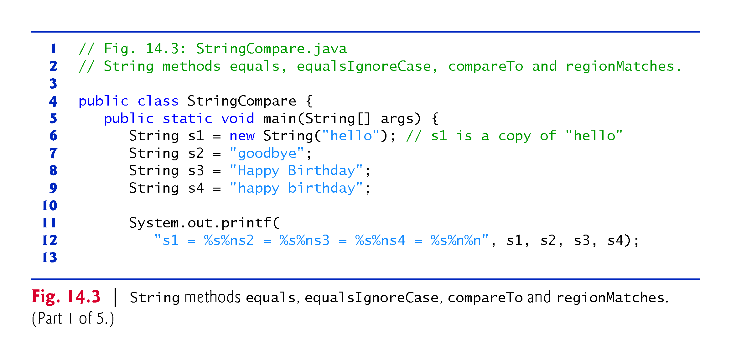

Slide 15
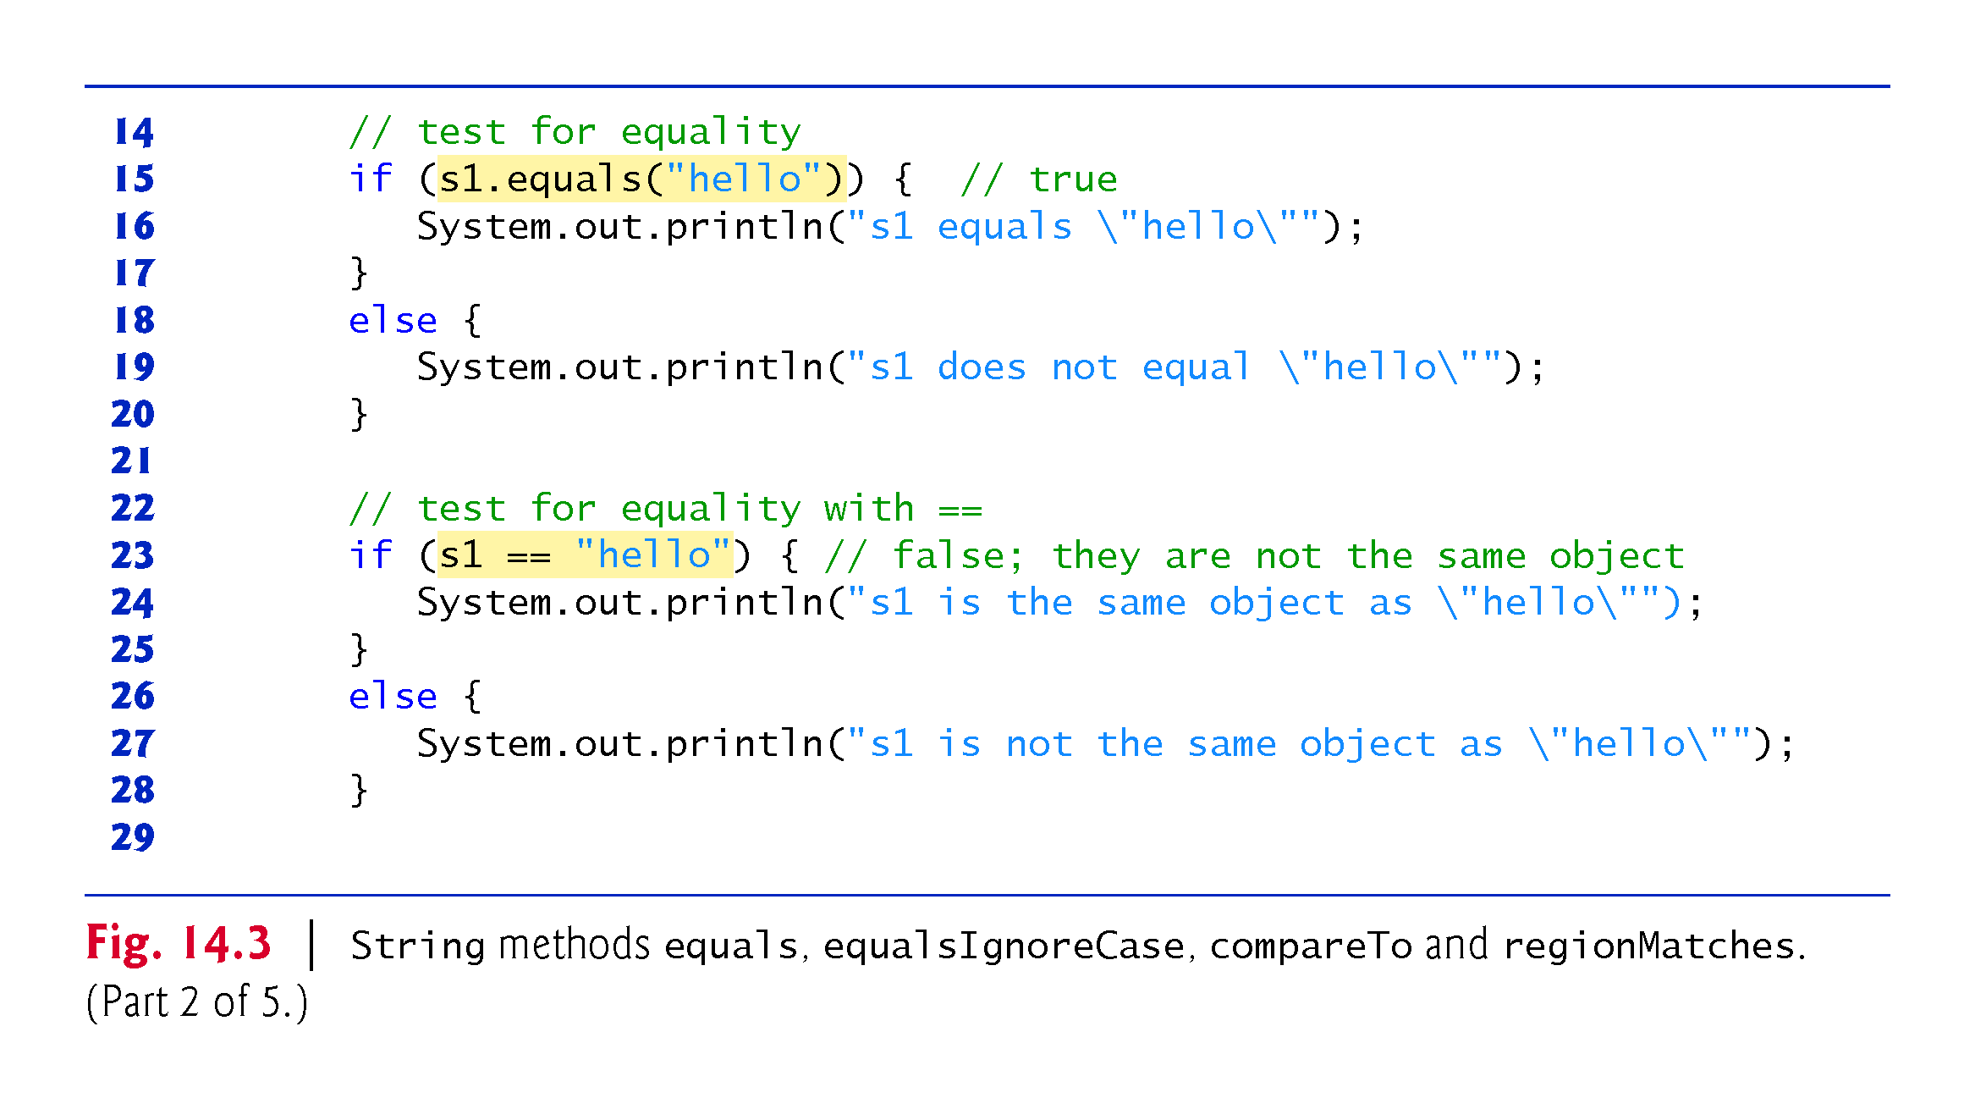

Slide 16
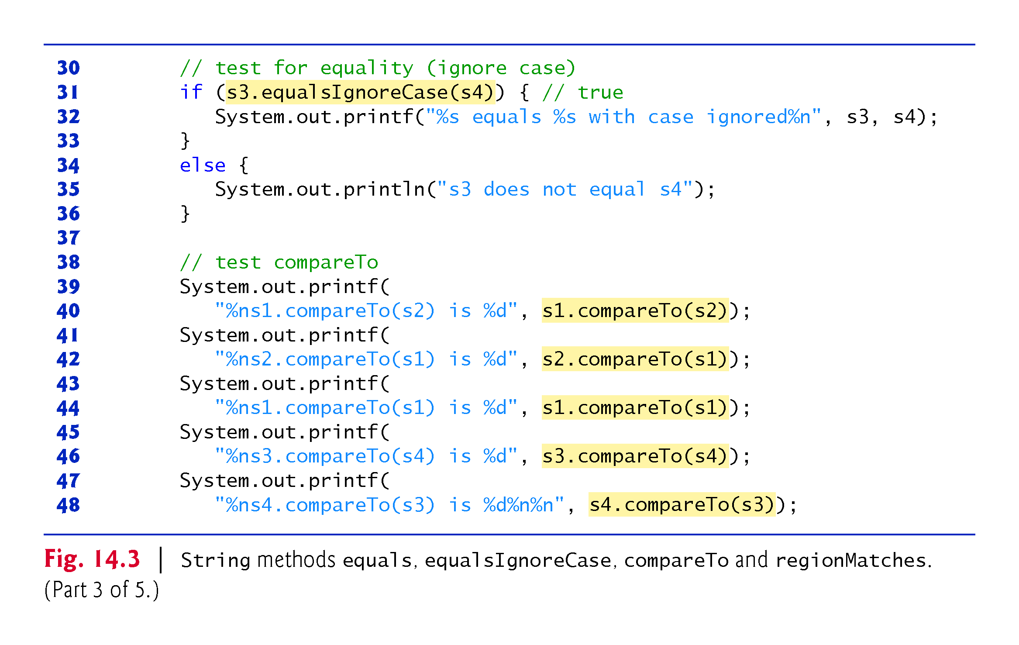

Slide 17
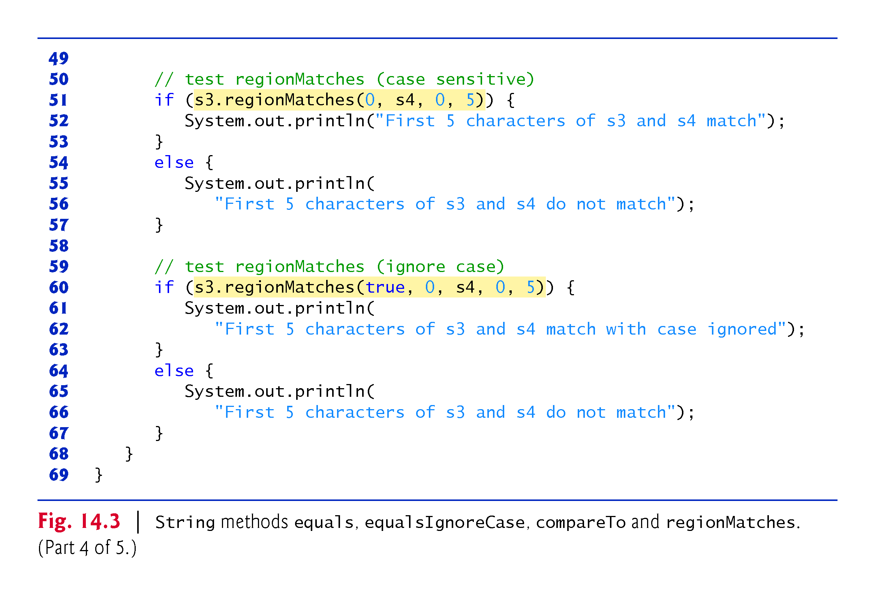

Slide 18
Class String methods
methods startsWith and endsWith
determine whether strings start with or end with a particular set of characters.
versions of String methods indexOf and lastIndexOf:
search for a specified character or substring in a String.
CMPS 251 (Object-Oriented Programming), Mohammad Saleh, Spring 2015, CSE-CENG-QU

Slide 19
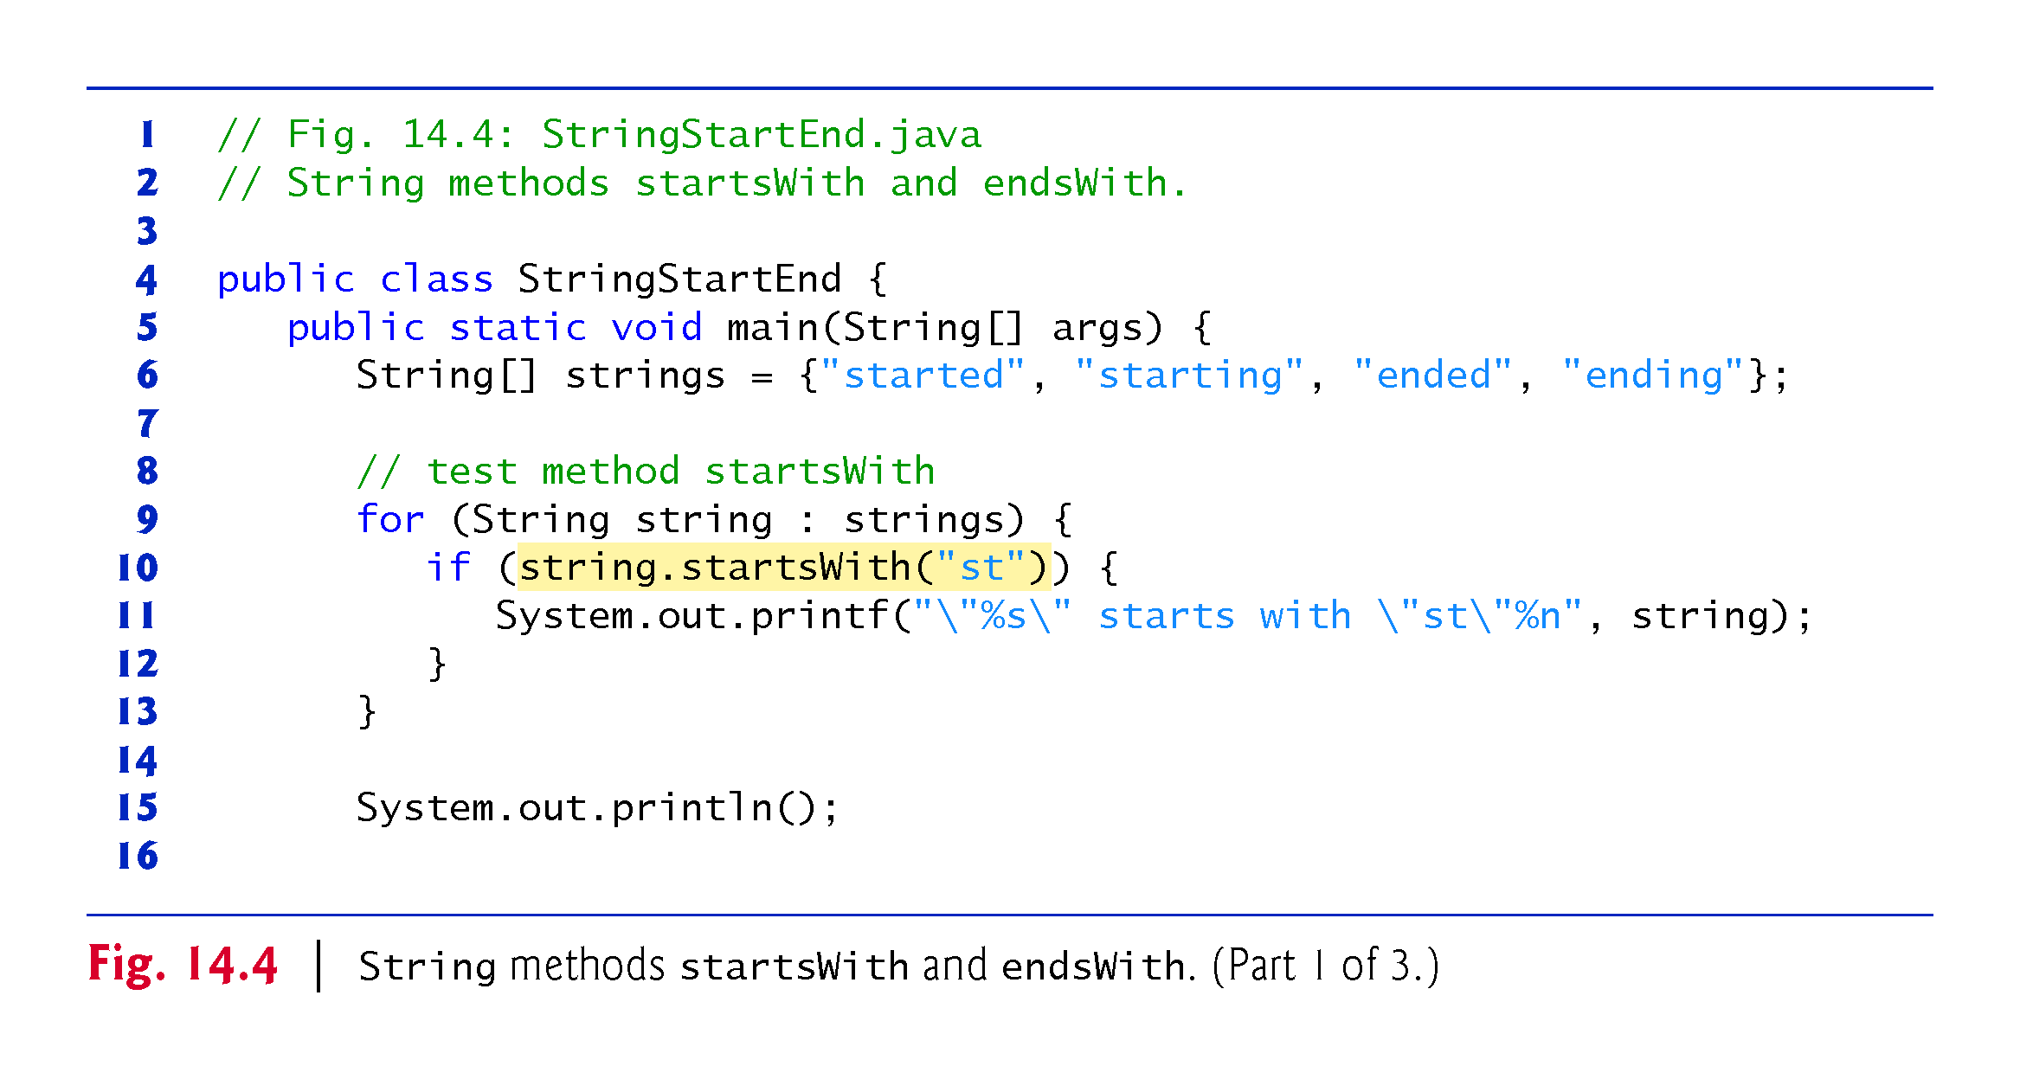

Slide 20
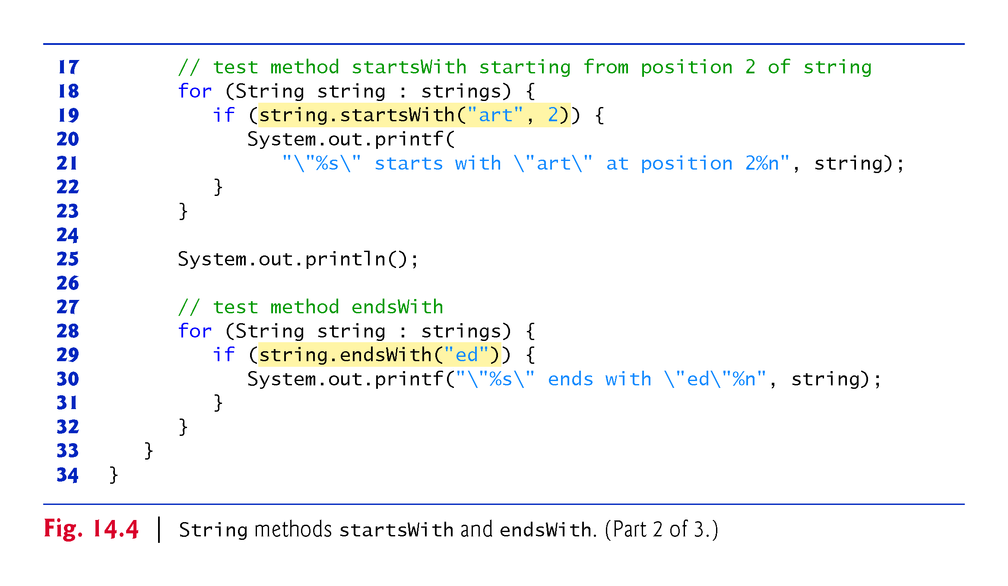

Slide 21
Class String methods
Method indexOf with one integer argument:
locates the first occurrence of a character in a String. If the method finds the character, it returns the character’s index in the String—otherwise, it returns –1.
Method indexOf with two integer arguments:
the character and the starting index at which the search of the String should begin.
Method lastIndexOf with one integer argument:
locates the last occurrence of a character in a String.
The method searches from the end of the String toward the beginning.
If it finds the character, it returns the character’s index in the String—otherwise, it returns –1.
Method lastIndexOf with two integer arguments:
the integer representation of the character and the index from which to begin searching backward.
There are also versions of these methods that search for substrings in Strings.
CMPS 251 (Object-Oriented Programming), Mohammad Saleh, Spring 2015, CSE-CENG-QU

Slide 22
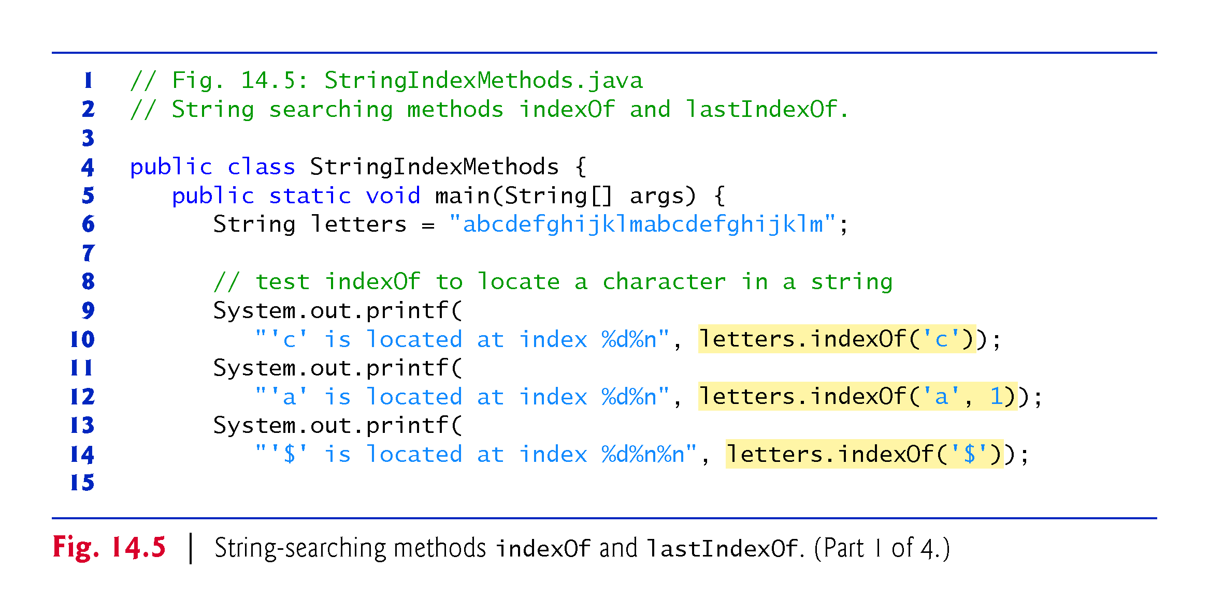

Slide 23
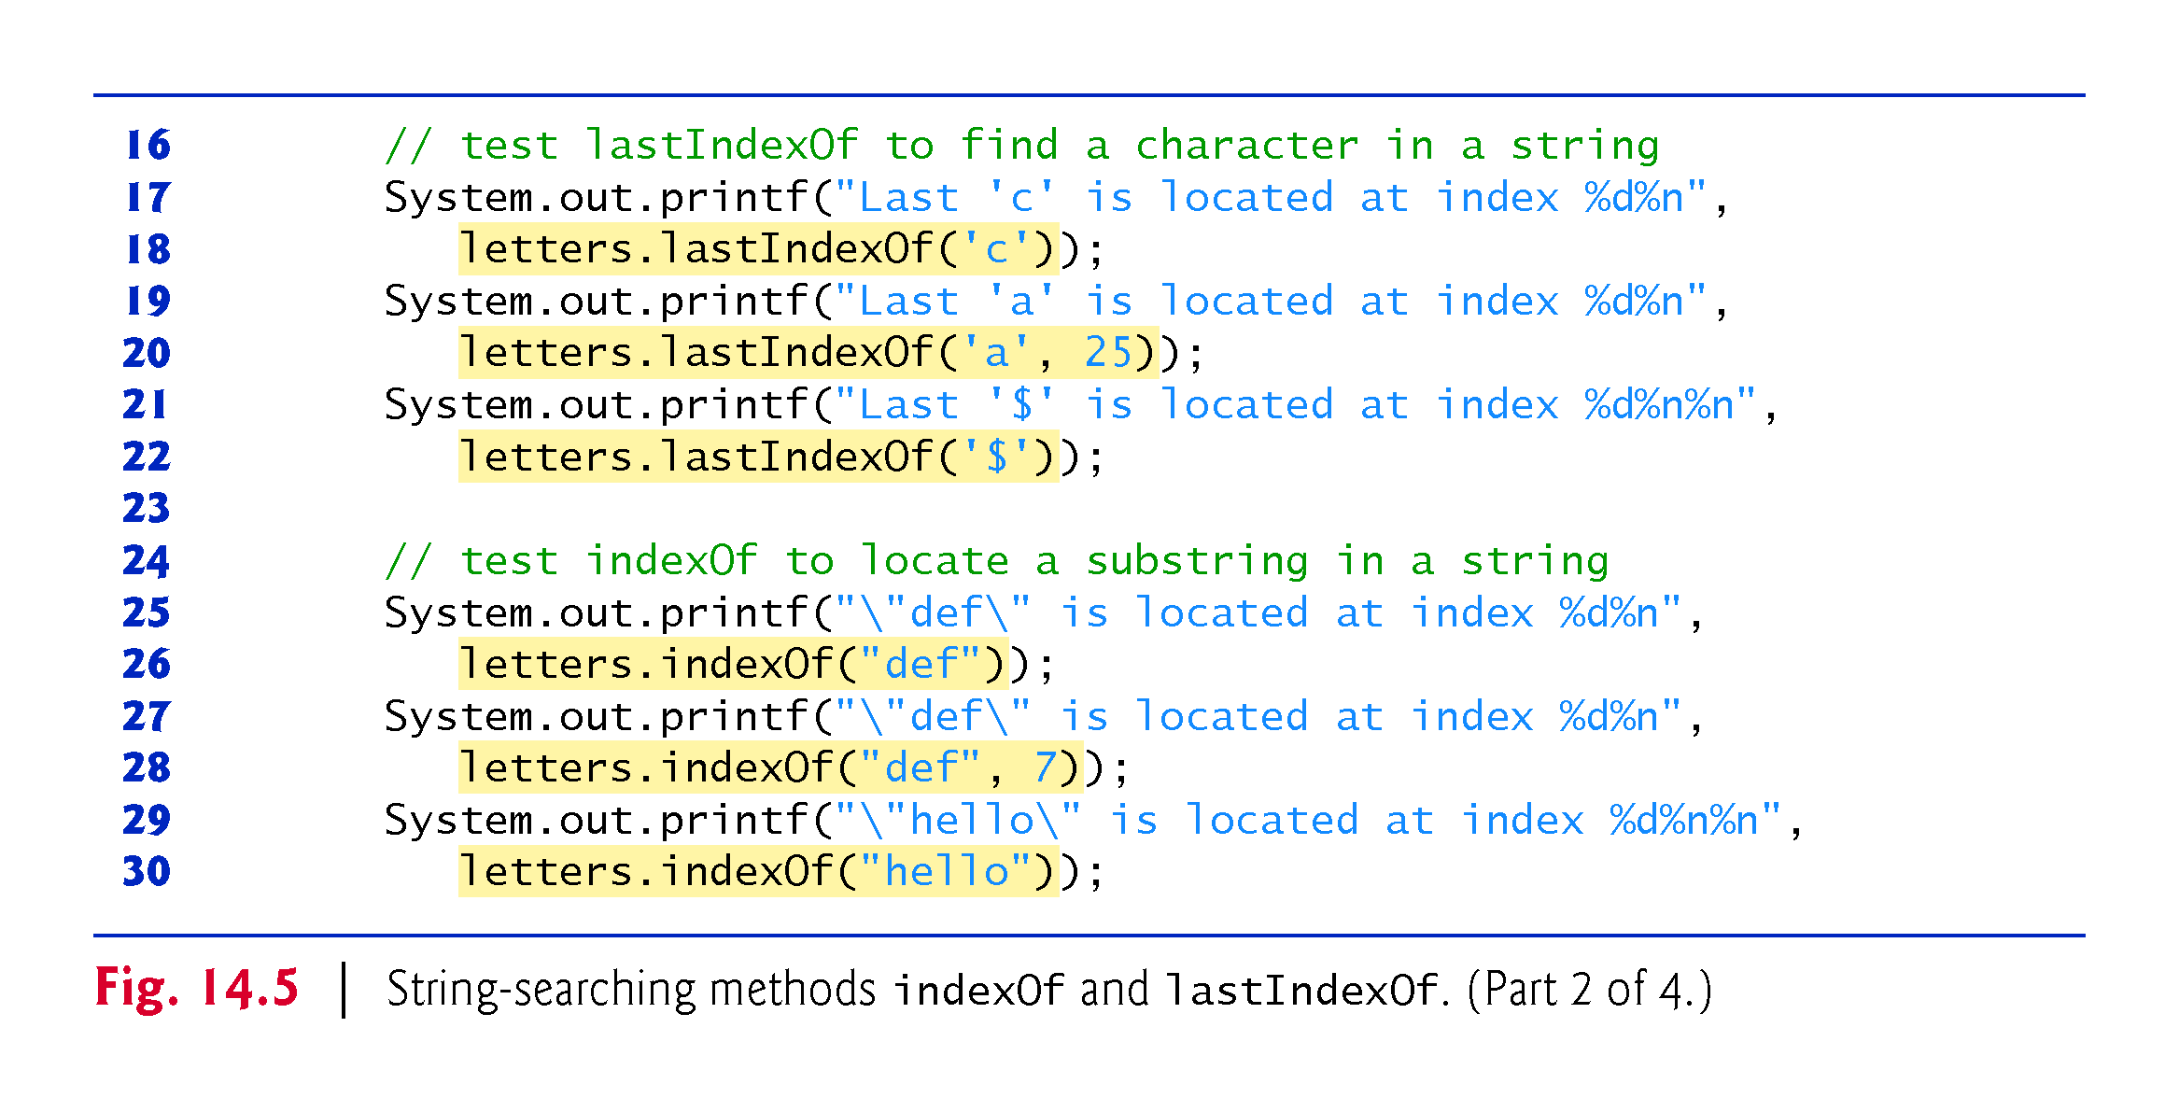

Slide 24
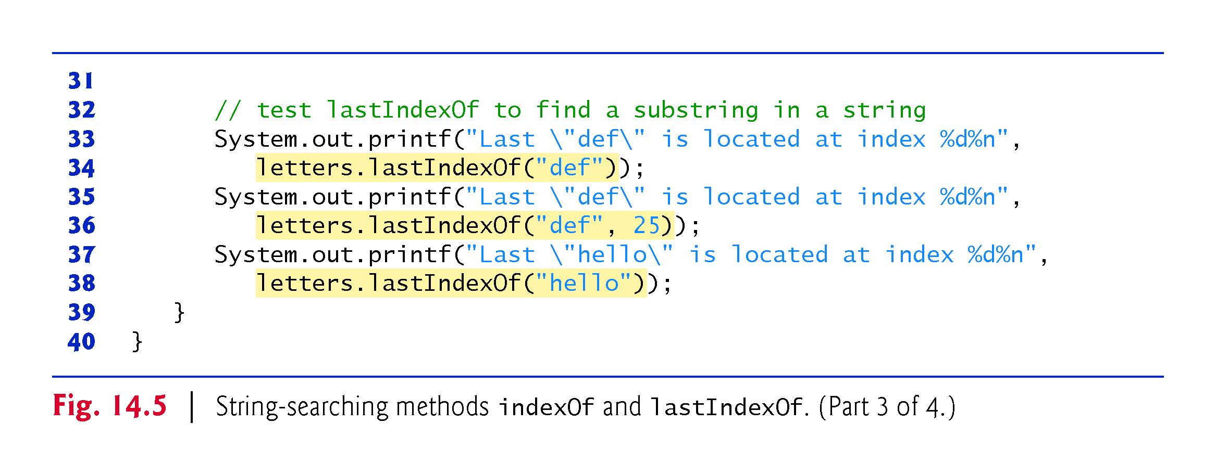

Slide 25
Class String methods
Method substring:
enables a new String object to be created by copying part of an existing String object.
The method returns a new String object.
With one integer argument:
specifies the starting index in the original String from which characters are to be copied.
With two integer arguments:
the starting index from which to copy characters in the original String and the index one beyond the last character to copy.
CMPS 251 (Object-Oriented Programming), Mohammad Saleh, Spring 2015, CSE-CENG-QU

Slide 26
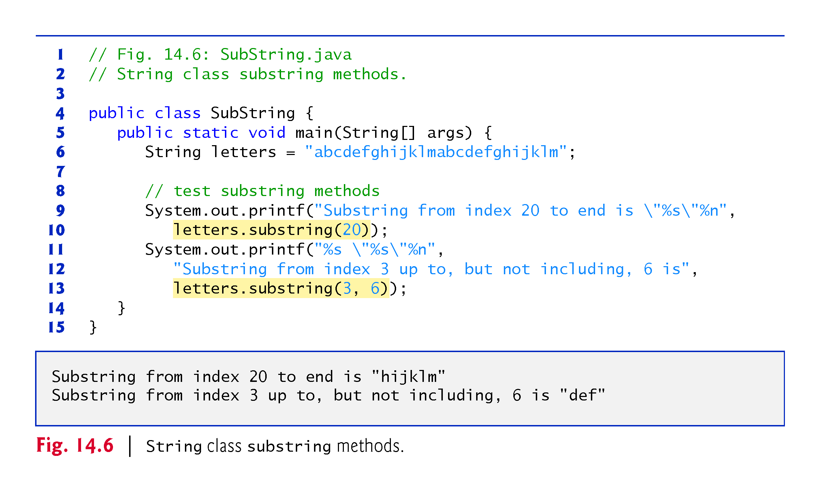

Slide 27
Class String methods
Method concat:
concatenates two String objects
returns a new String object containing the characters from both original Strings.
The original Strings are not modified.
Method replace:
return a new String object in which every occurrence of the first char argument is replaced with the second.
An overloaded version enables you to replace substrings rather than individual characters.
CMPS 251 (Object-Oriented Programming), Mohammad Saleh, Spring 2015, CSE-CENG-QU

Slide 28
Class String methods
Method toUpperCase:
generates a new String with uppercase letters.
Method toLowerCase:
returns a new String object with lowercase letters.
Method trim:
generates a new String object that removes all whitespace characters that appear at the beginning or end of the String on which trim operates.
Method toCharArray:
creates a new character array containing a copy of the characters in the String.
CMPS 251 (Object-Oriented Programming), Mohammad Saleh, Spring 2015, CSE-CENG-QU

Slide 29
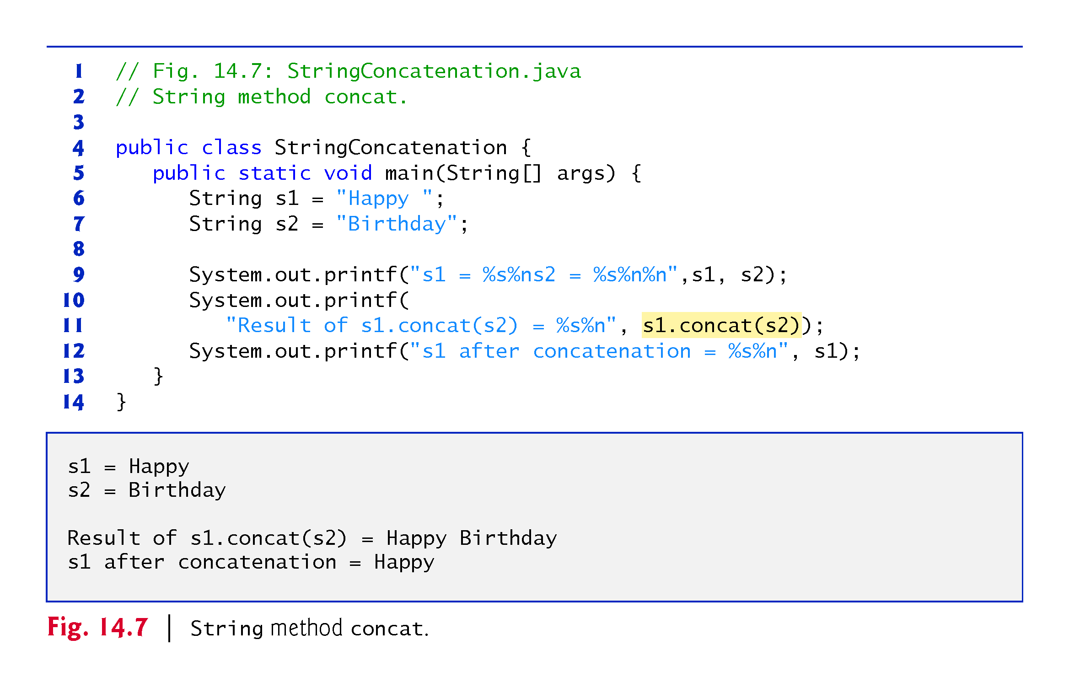

Slide 30
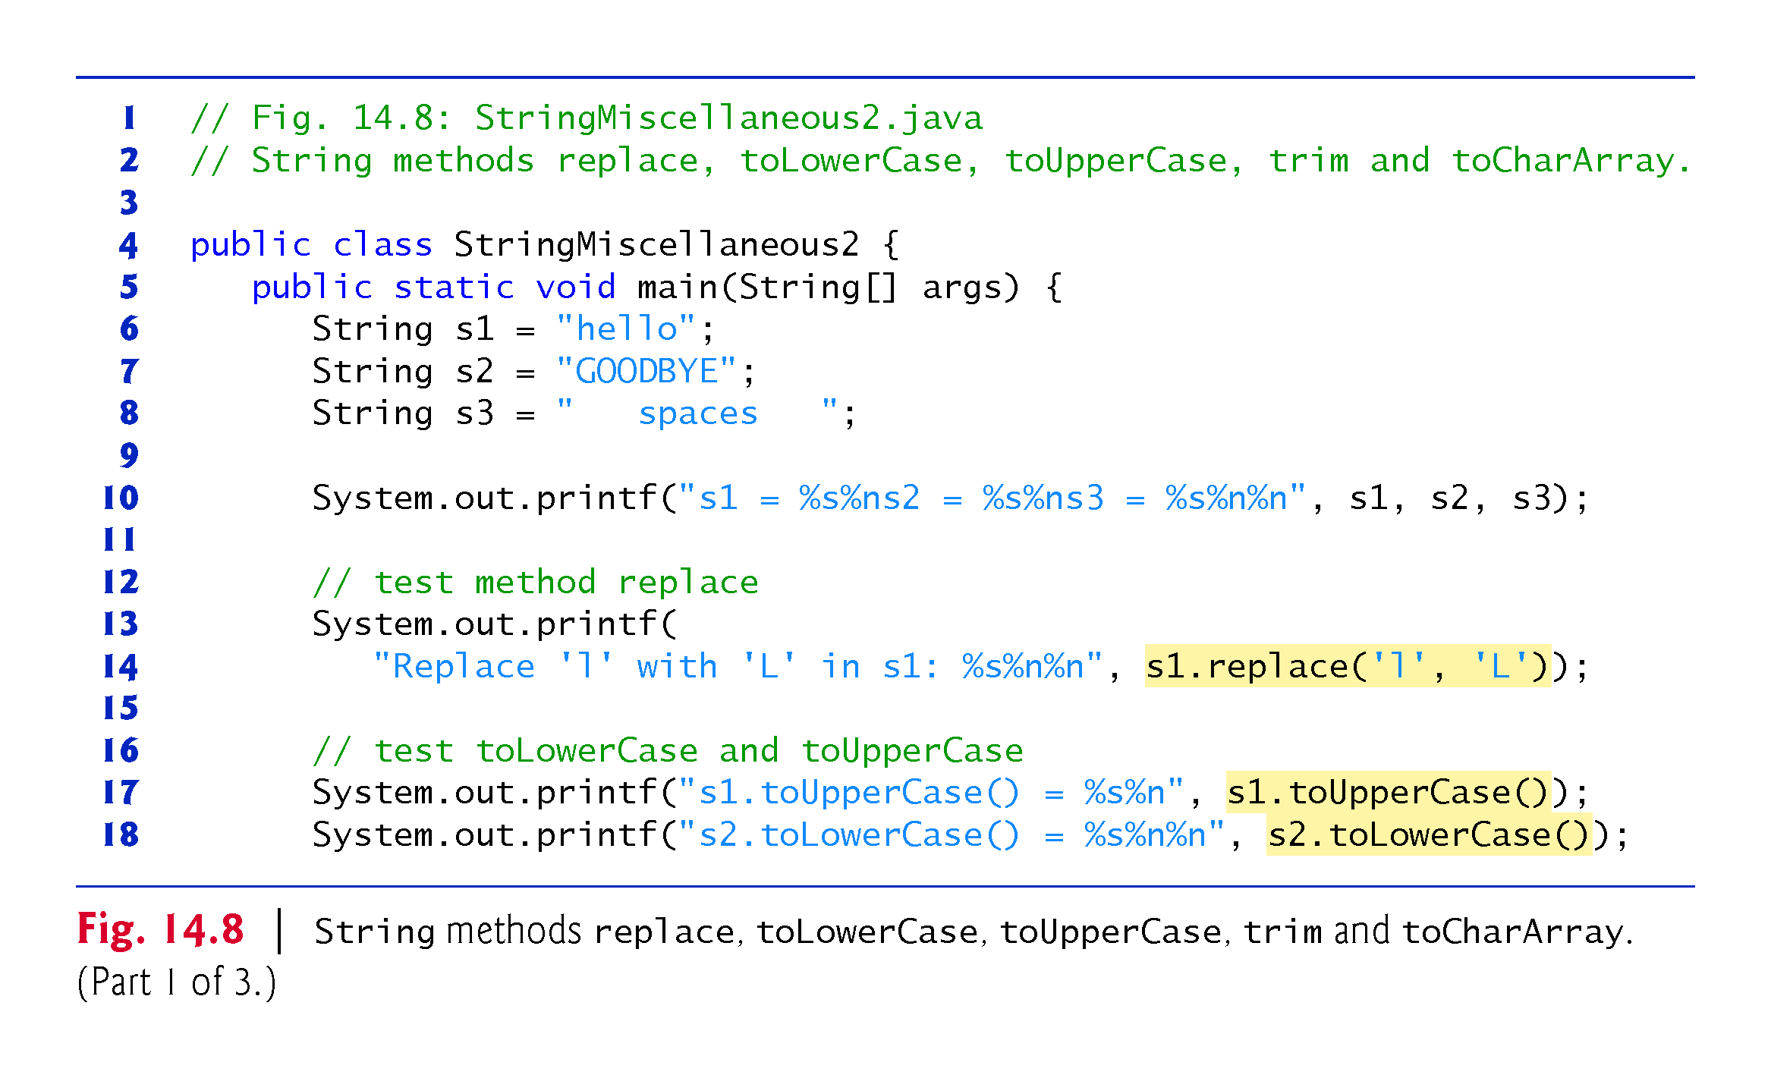

Slide 31
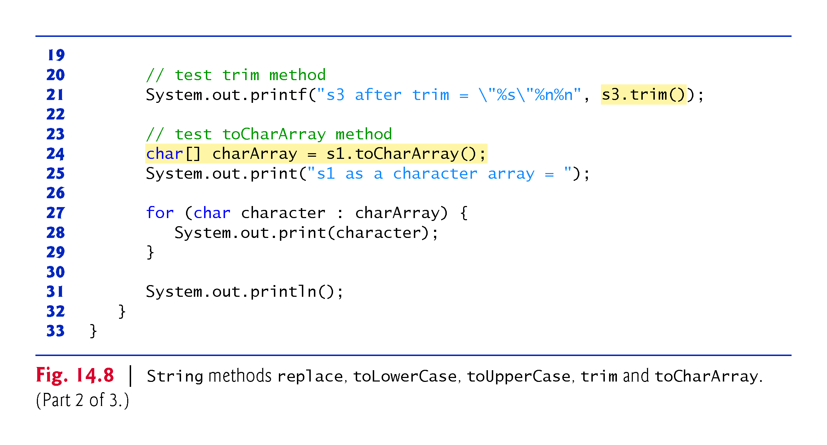

Slide 32
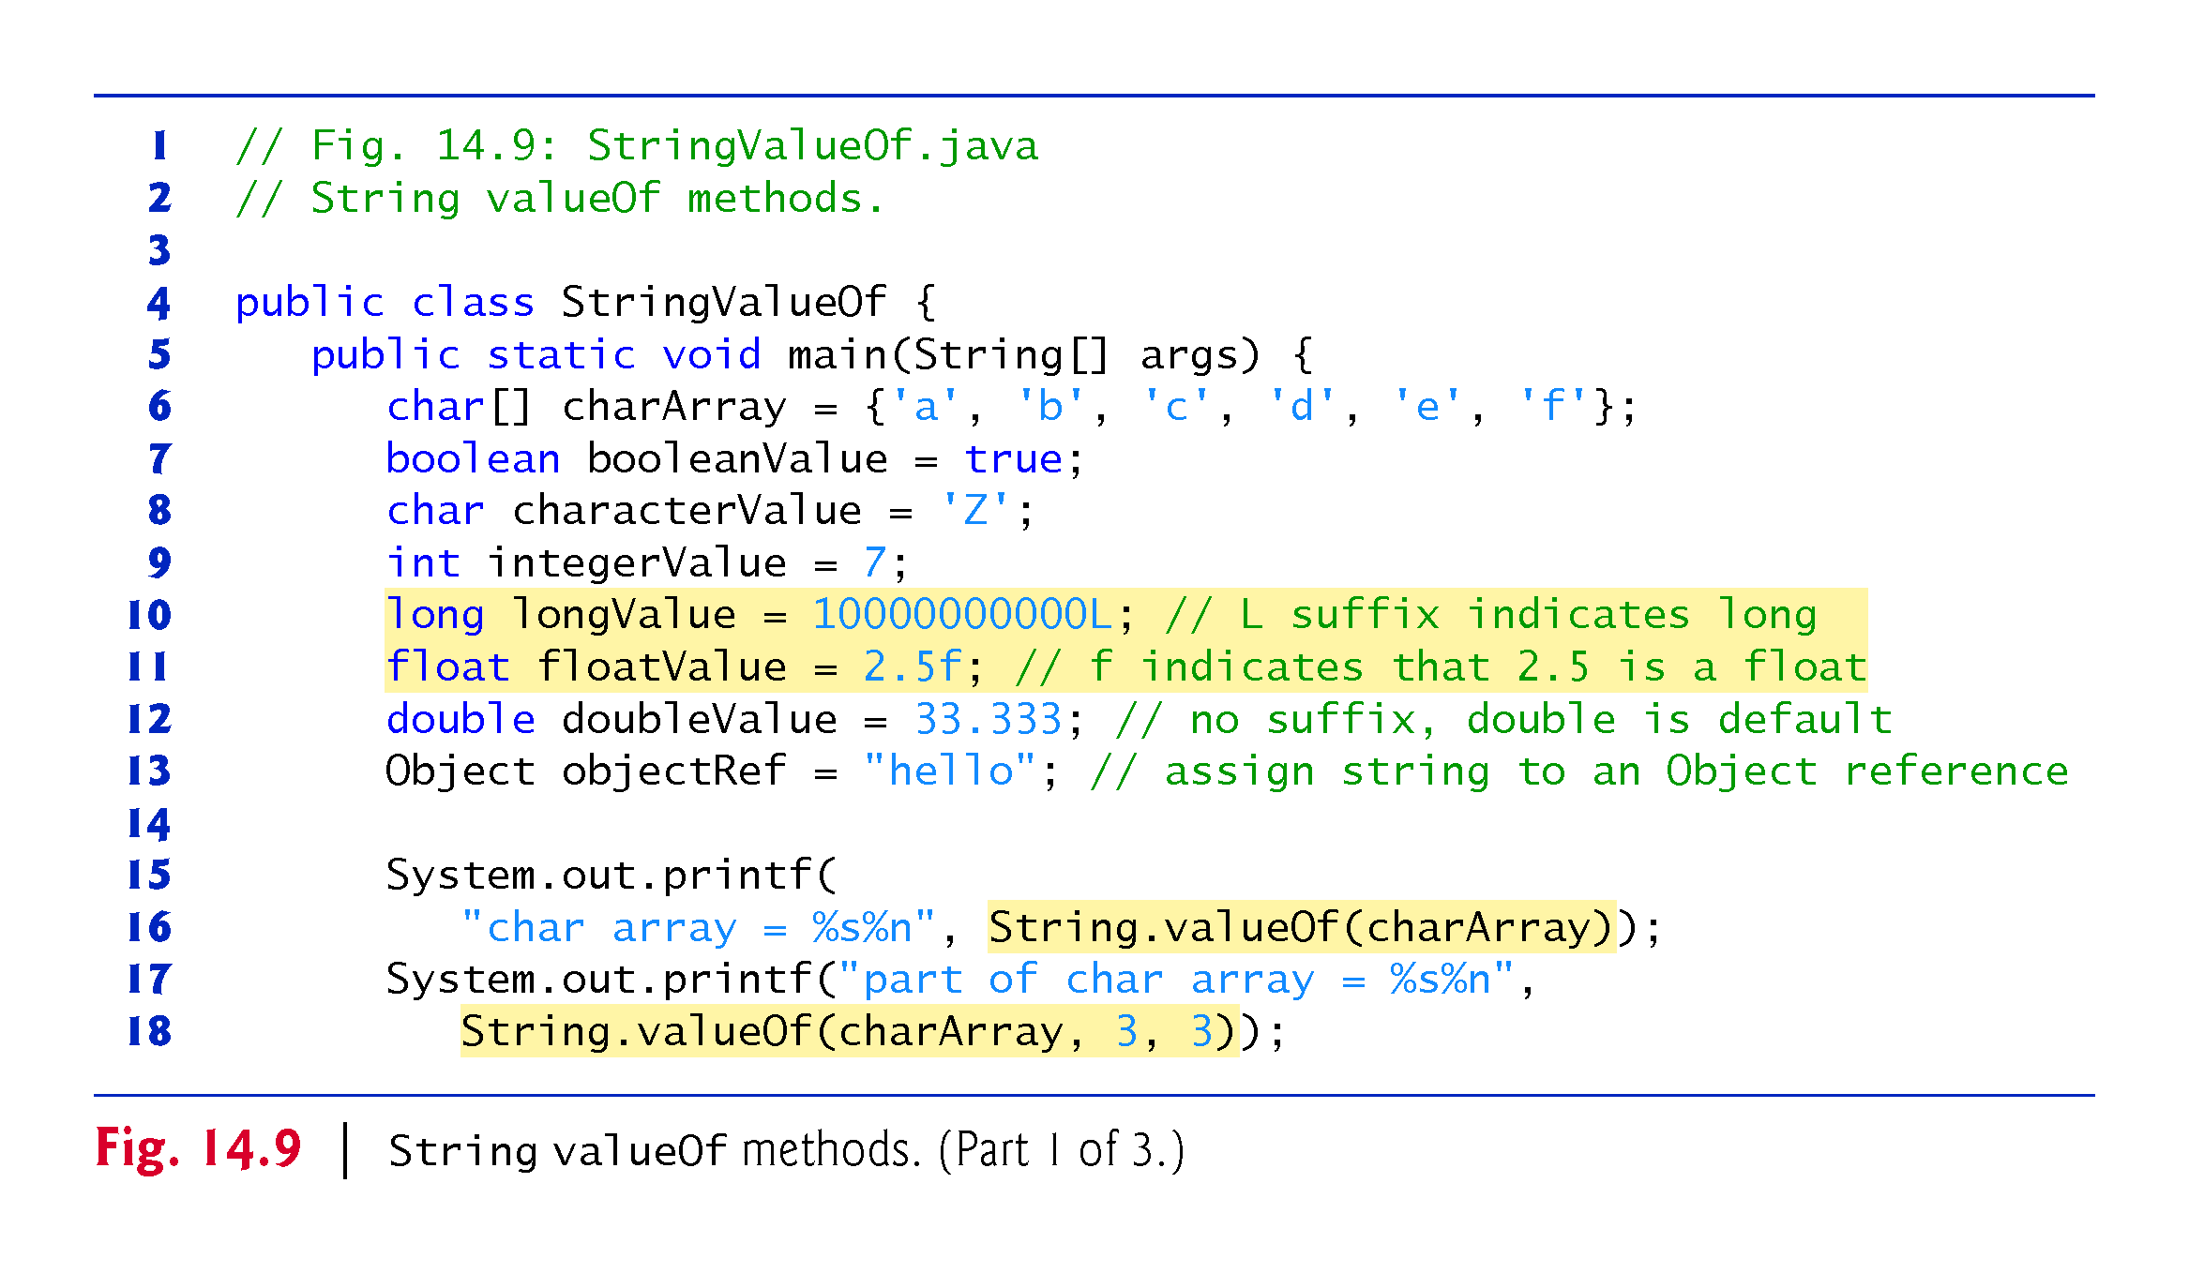
Class String methods
Static method valueOf:
takes an argument of any type and convert it to a String object.
CMPS 251 (Object-Oriented Programming), Mohammad Saleh, Spring 2015, CSE-CENG-QU

Slide 33
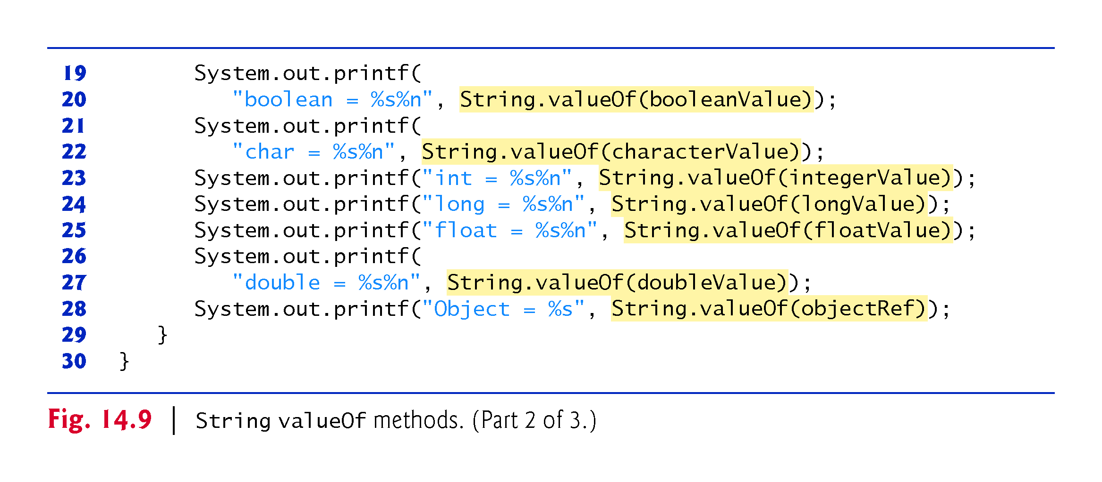

Slide 34
Class Character
Eight type-wrapper classes that enable primitive-type values to be treated as objects:
Boolean, Character, Double, Float, Byte, Short, Integer and Long
Most Character methods are static methods.
designed for convenience in processing individual char values.
CMPS 251 (Object-Oriented Programming), Mohammad Saleh, Spring 2015, CSE-CENG-QU

Slide 35
Class Character Methods
Method isDefined:
determines whether a character is defined in the Unicode character set.
Method isDigit:
determines whether a character is a defined Unicode digit.
Method isJavaIdentifierStart:
determines whether a character can be the first character of an identifier in Java—that is, a letter, an underscore (_) or a dollar sign ($).
Method isJavaIdentifierPart:
determine whether a character can be used in an identifier in Java—that is, a digit, a letter, an underscore (_) or a dollar sign ($).
CMPS 251 (Object-Oriented Programming), Mohammad Saleh, Spring 2015, CSE-CENG-QU

Slide 36
Class Character Methods
Method isLetter:
determines whether a character is a letter.
Method isLetterOrDigit:
determines whether a character is a letter or a digit.
Method isLowerCase:
determines whether a character is a lowercase letter.
Method isUpperCase:
determines whether a character is an uppercase letter.
Method toUpperCase:
converts a character to its uppercase equivalent.
Method toLowerCase:
converts a character to its lowercase equivalent.
CMPS 251 (Object-Oriented Programming), Mohammad Saleh, Spring 2015, CSE-CENG-QU

Slide 37
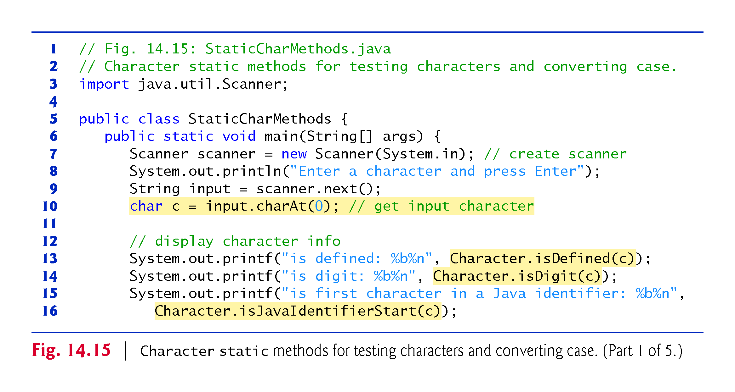

Slide 38
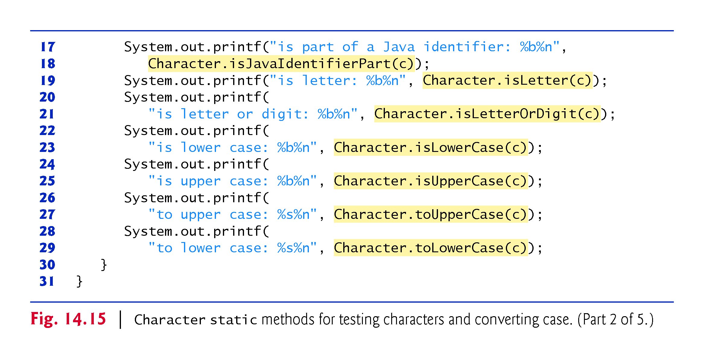

Slide 39
Class Character Methods
Methods digit and forDigit:
convert characters to digits and digits to characters, respectively, in different number systems.
Common number systems:
decimal (base 10), octal (base 8), hexadecimal (base 16) and binary (base 2).
The base of a number is also known as its radix.
For more information on conversions between number systems, see Appendix H.
CMPS 251 (Object-Oriented Programming), Mohammad Saleh, Spring 2015, CSE-CENG-QU

Slide 40
Class Character Methods
Method forDigit:
converts its first argument into a character in the number system specified by its second argument.
Method digit:
converts its first argument into an integer in the number system specified by its second argument.
The radix (second argument) must be between 2 and 36, inclusive.
CMPS 251 (Object-Oriented Programming), Mohammad Saleh, Spring 2015, CSE-CENG-QU

Slide 41
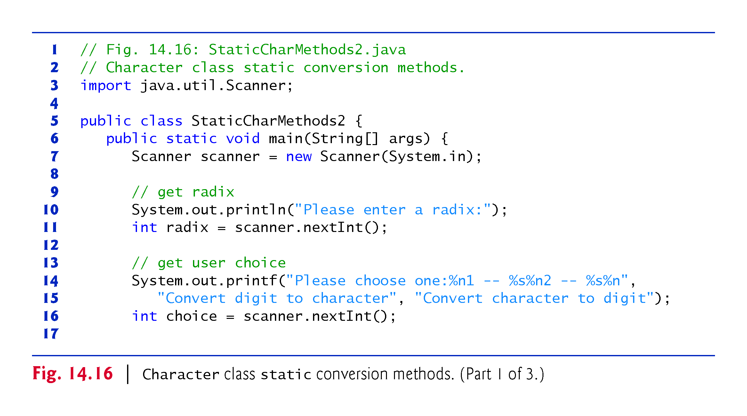

Slide 42
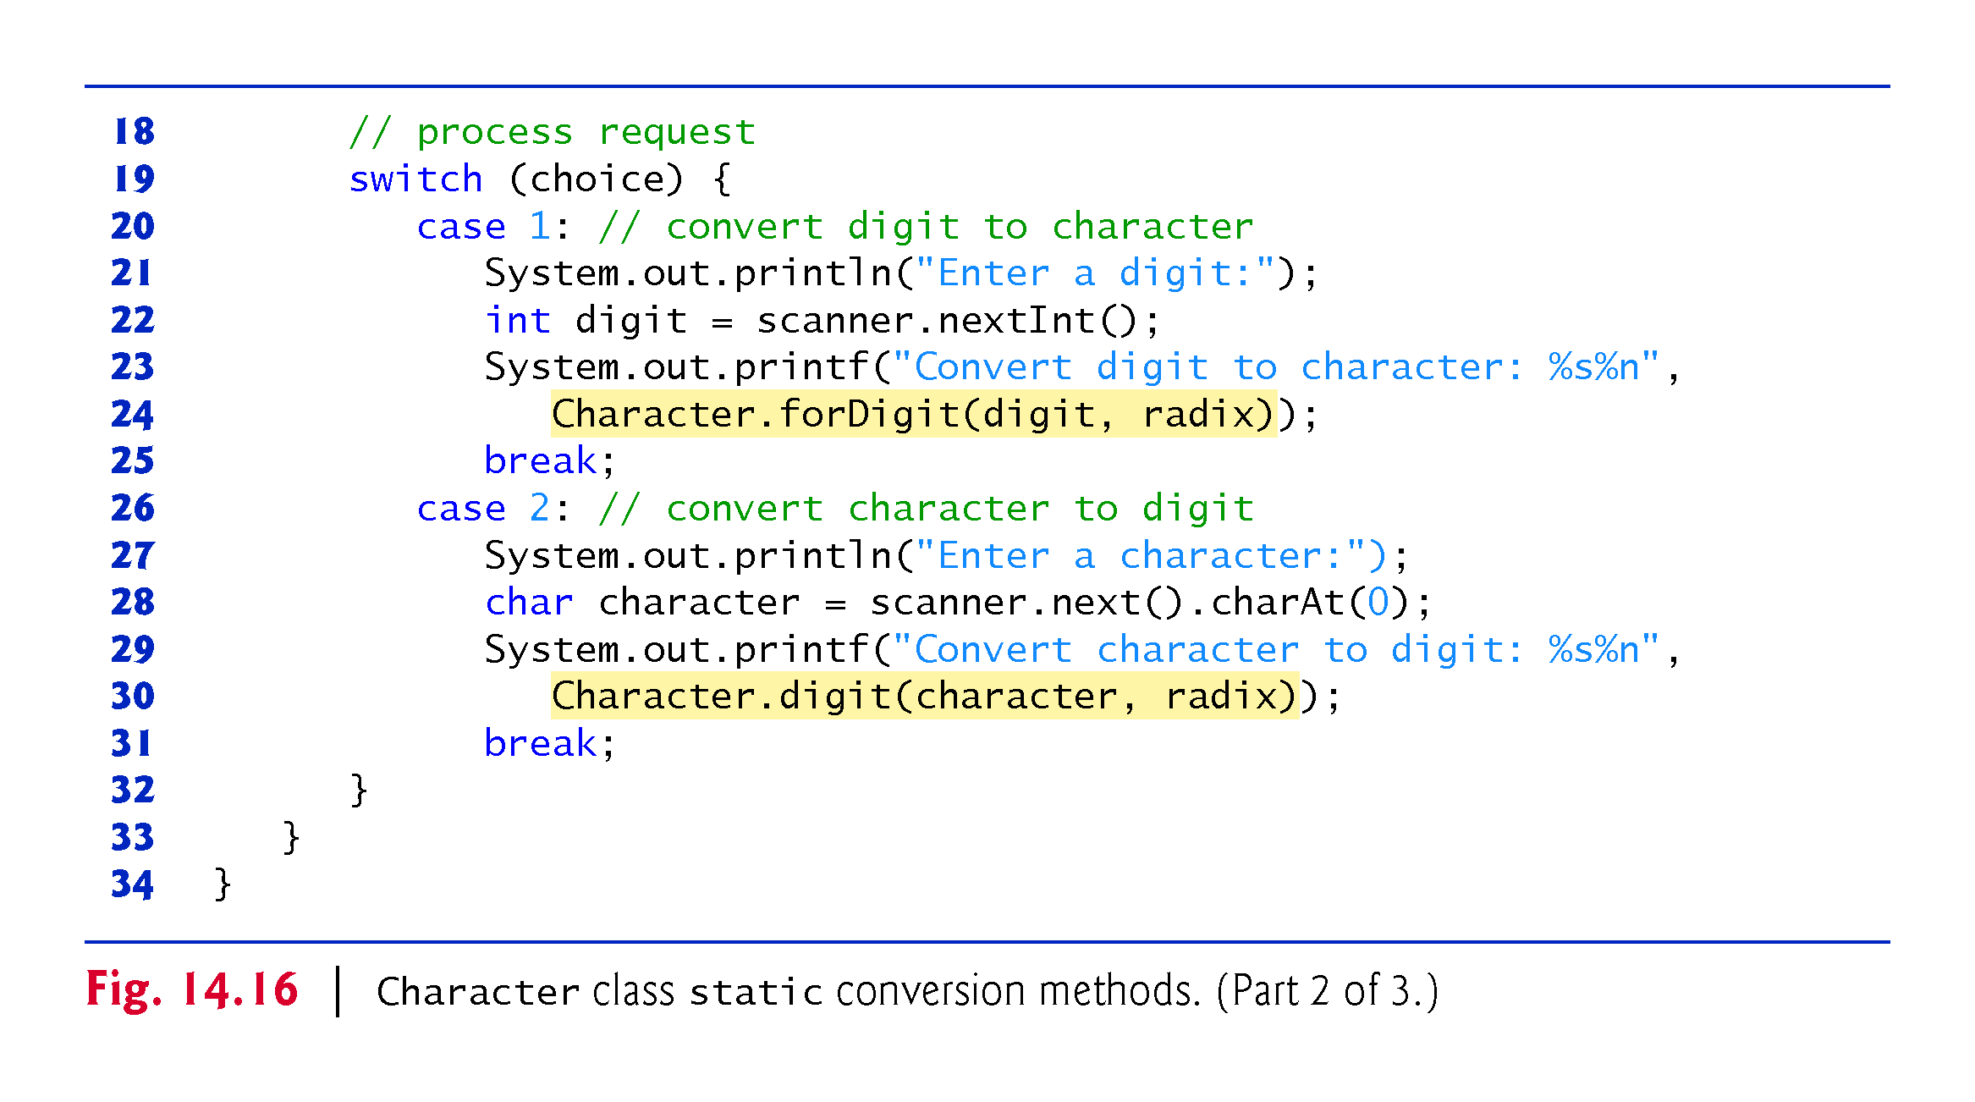

Slide 43
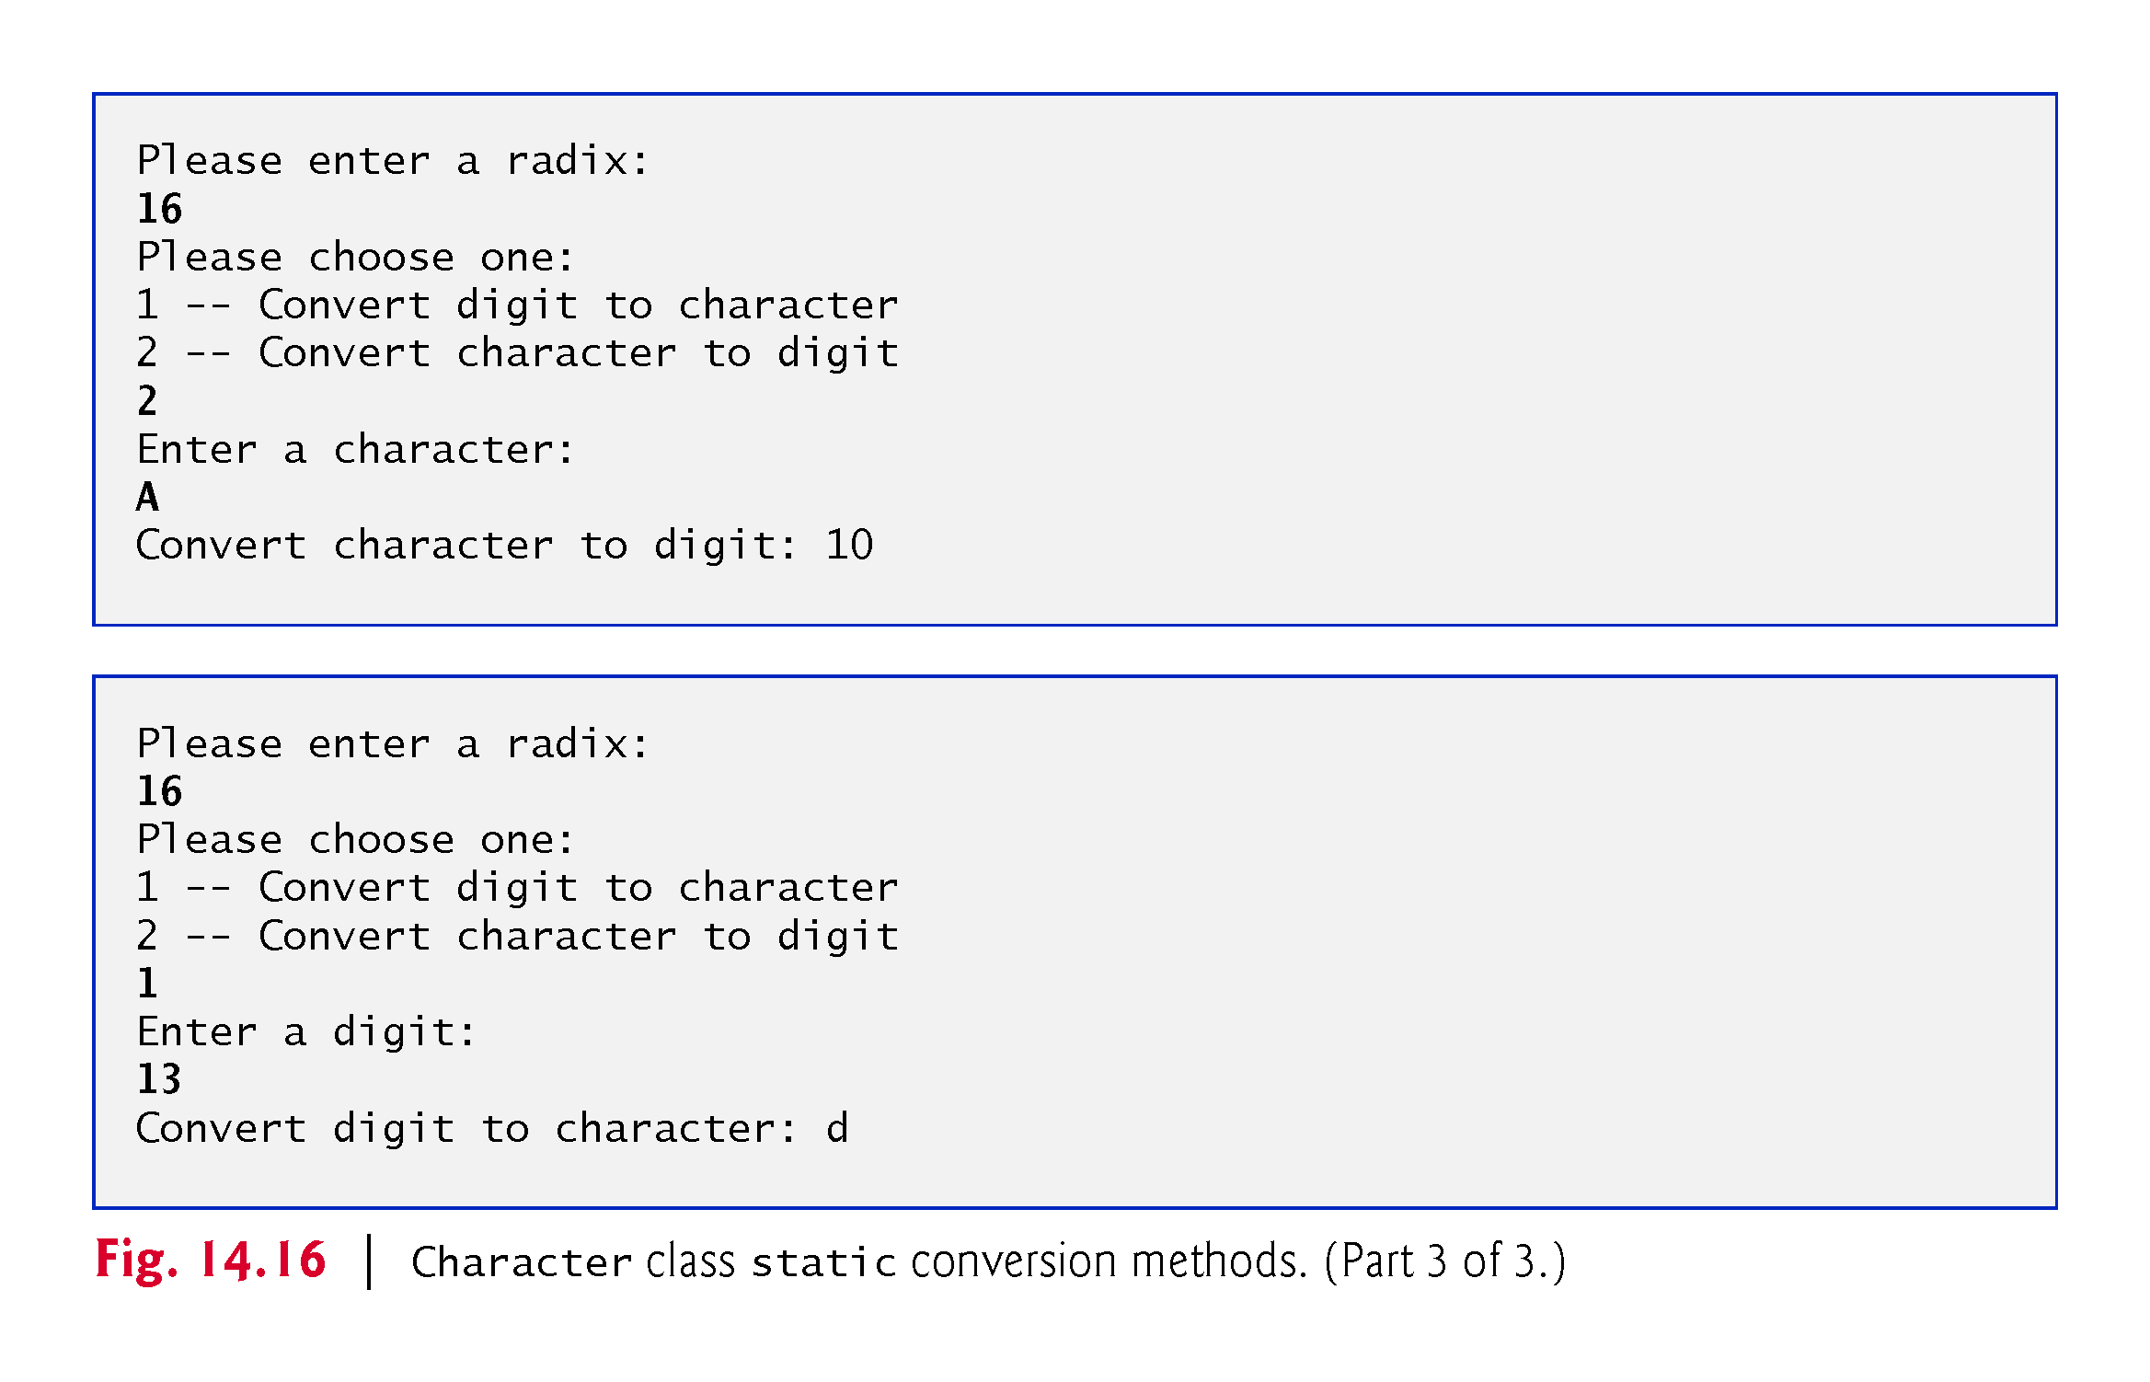

Slide 44
Class Character Methods
Java automatically converts char literals into Character objects when they are assigned to Character variables.
Process known as autoboxing.
Method charValue:
returns the char value stored in the object.
Method toString:
returns the String representation of the char value stored in the object.
Method equals:
determines if two Characters have the same contents.
CMPS 251 (Object-Oriented Programming), Mohammad Saleh, Spring 2015, CSE-CENG-QU

Slide 45
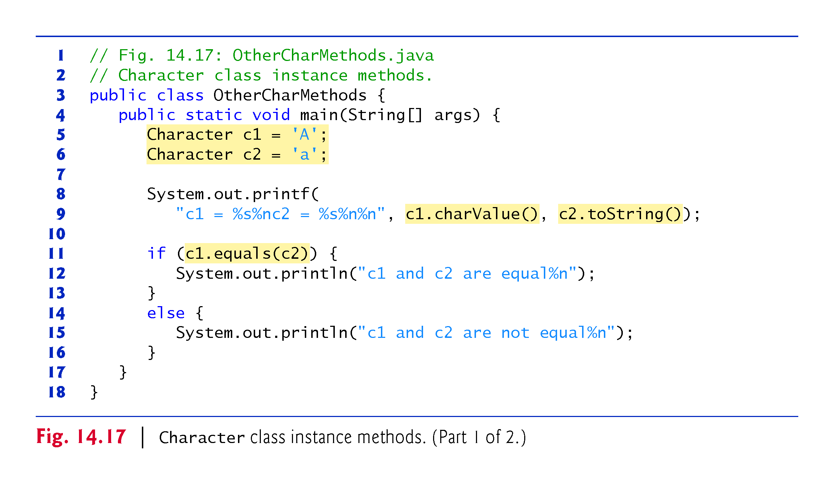

Slide 46
Tokenizing Strings
When you read a sentence, your mind breaks it into tokens
individual words and punctuation marks that convey meaning.
Compilers also perform tokenization.
String method split:
breaks a String into its component tokens
returns an array of Strings.
Tokens are separated by delimiters
Typically white-space characters such as space, tab, newline and carriage return.
Other characters can also be used as delimiters to separate tokens.
CMPS 251 (Object-Oriented Programming), Mohammad Saleh, Spring 2015, CSE-CENG-QU

Slide 47
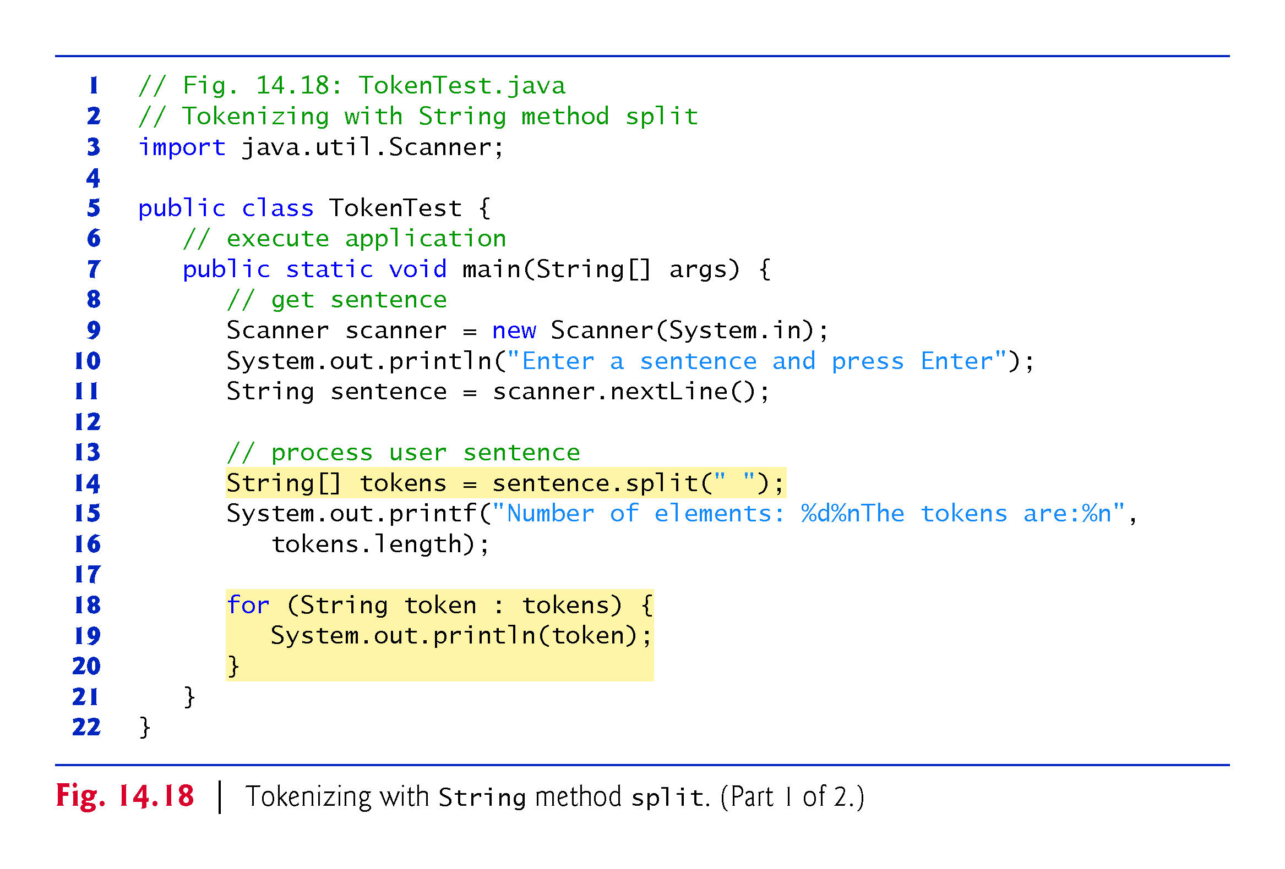

Slide 48
StringBuilder class
Used to create and manipulate dynamic string information.
Modifiable strings
Use it when you have lots of string concatenation or modification.
Every StringBuilder is capable of storing a number of characters specified by its capacity.
If the capacity of a StringBuilder is exceeded, the capacity expands to accommodate the additional characters.
CMPS 251 (Object-Oriented Programming), Mohammad Saleh, Spring 2015, CSE-CENG-QU

Slide 49
StringBuilder constructors
No-argument constructor:
creates a StringBuilder with no characters in it and an initial capacity of 16 characters.
Constructor that takes an integer argument :
creates a StringBuilder with no characters in it and the initial capacity specified by the integer argument.
Constructor that takes a String argument:
creates a StringBuilder containing the characters in the String argument. The initial capacity is the number of characters in the String argument plus 16.
Method toString of class StringBuilder returns the StringBuilder contents as a String.
CMPS 251 (Object-Oriented Programming), Mohammad Saleh, Spring 2015, CSE-CENG-QU

Slide 50
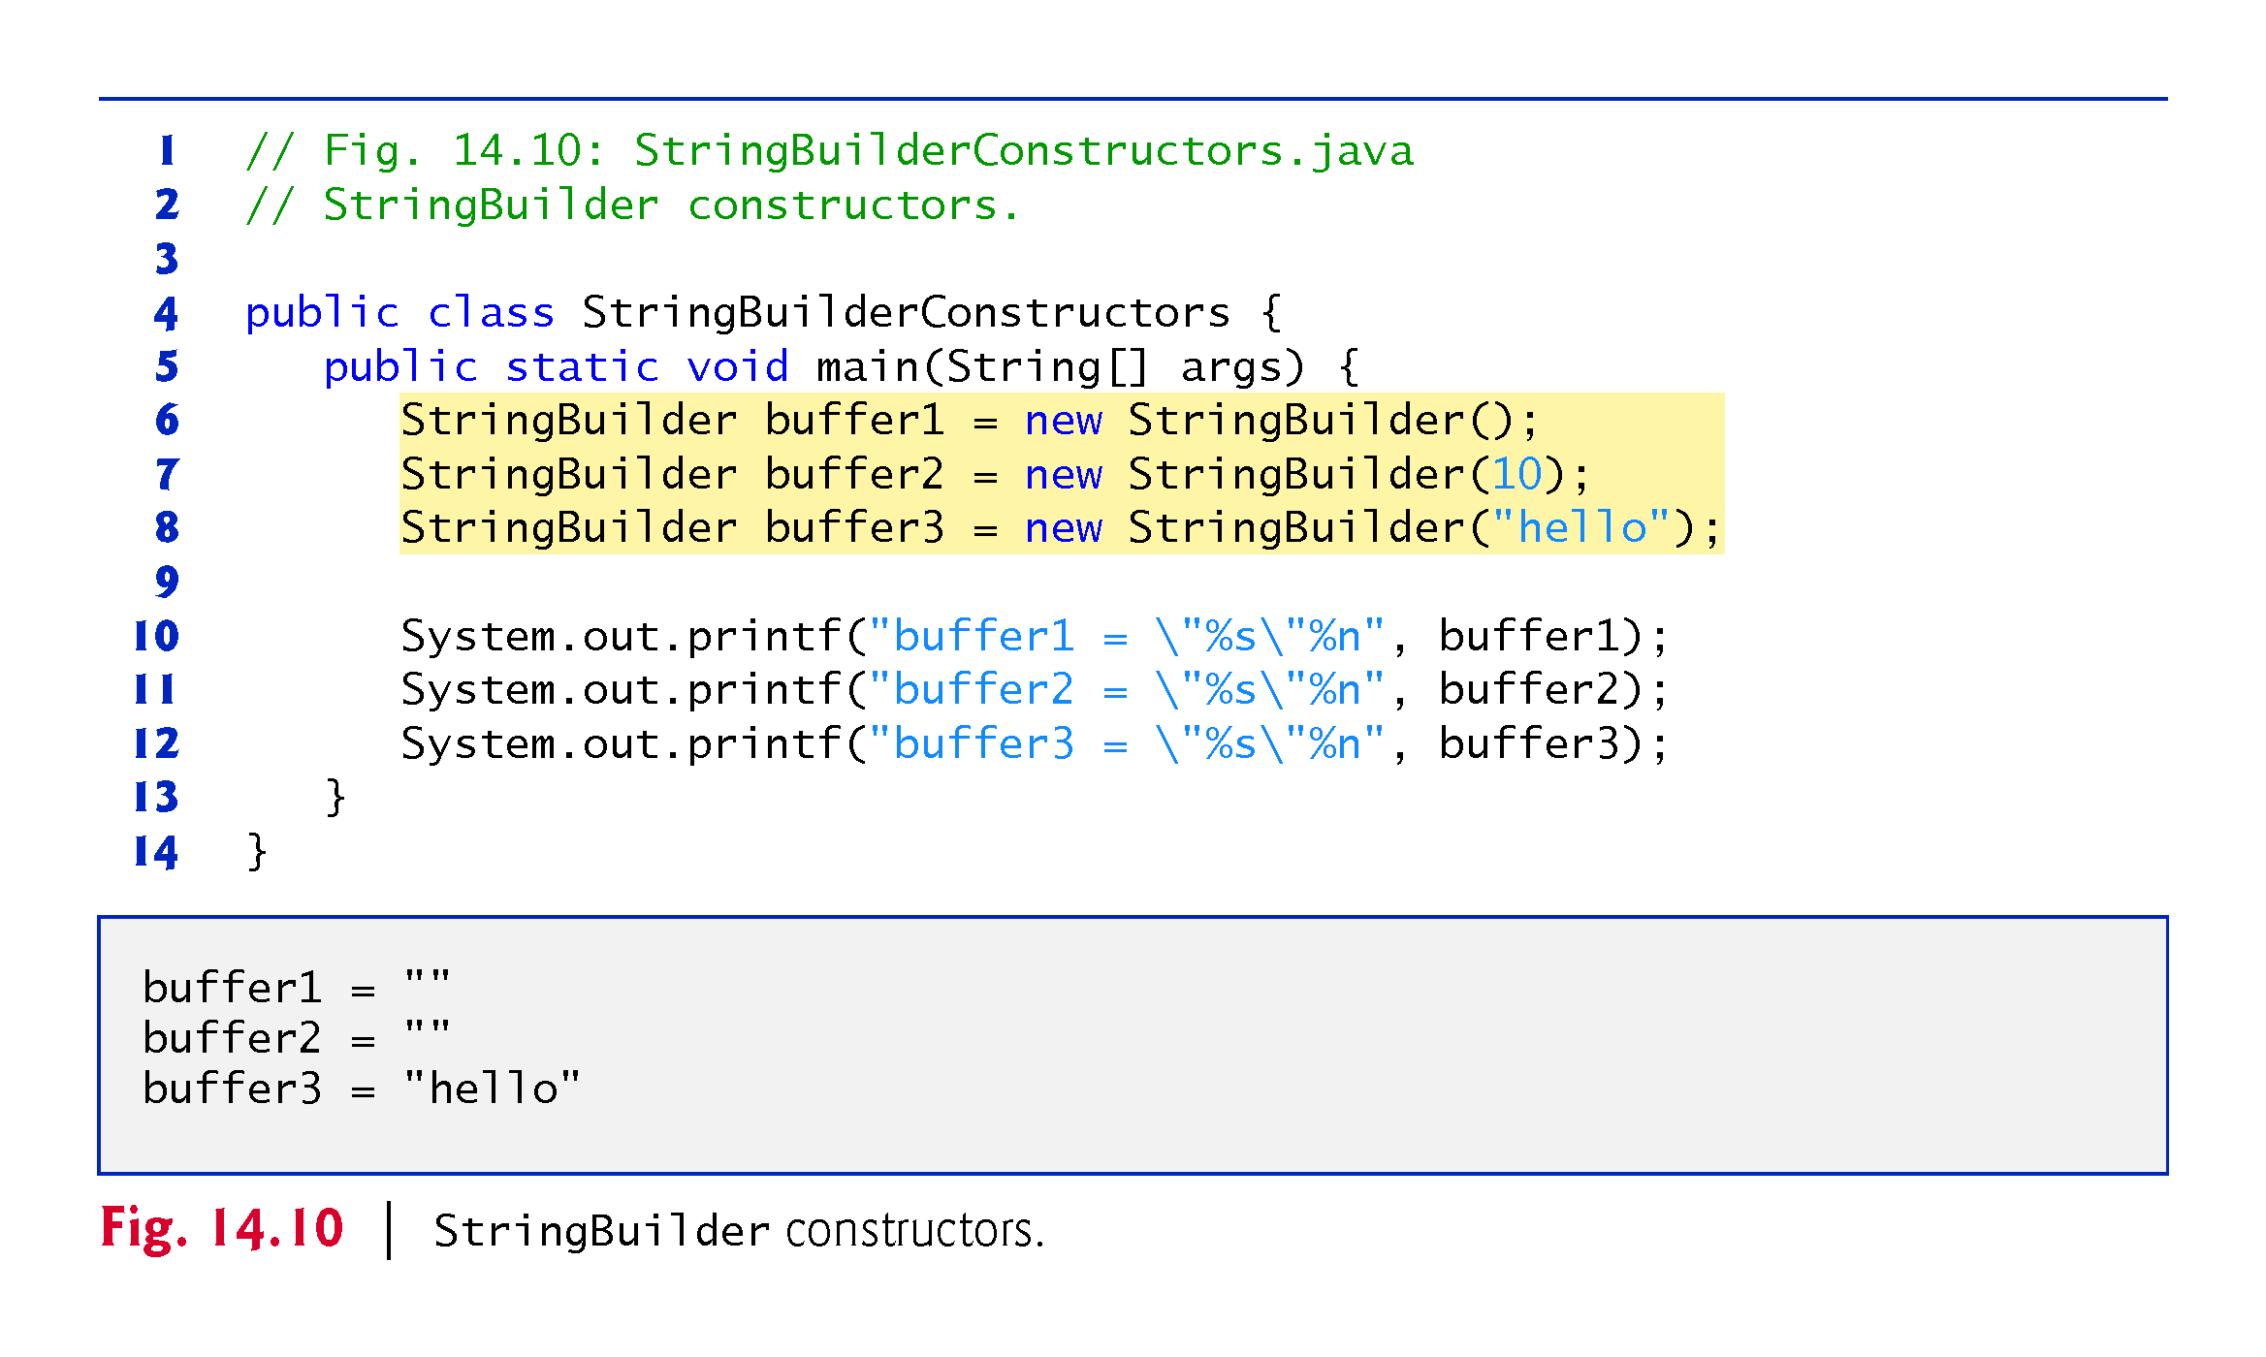

Slide 51
StringBuilder Methods
Methods length and capacity :
return the number of characters currently in a StringBuilder and the number of characters that can be stored in a without allocating more memory, respectively.
Method ensureCapacity:
guarantees that a StringBuilder has at least the specified capacity.
Method setLength:
increases or decreases the length of a StringBuilder.
If the specified length is less than the current number of characters, the buffer is truncated to the specified length.
If the specified length is greater than the number of characters, null characters are appended until the total number of characters in the StringBuilder is equal to the specified length.
CMPS 251 (Object-Oriented Programming), Mohammad Saleh, Spring 2015, CSE-CENG-QU

Slide 52
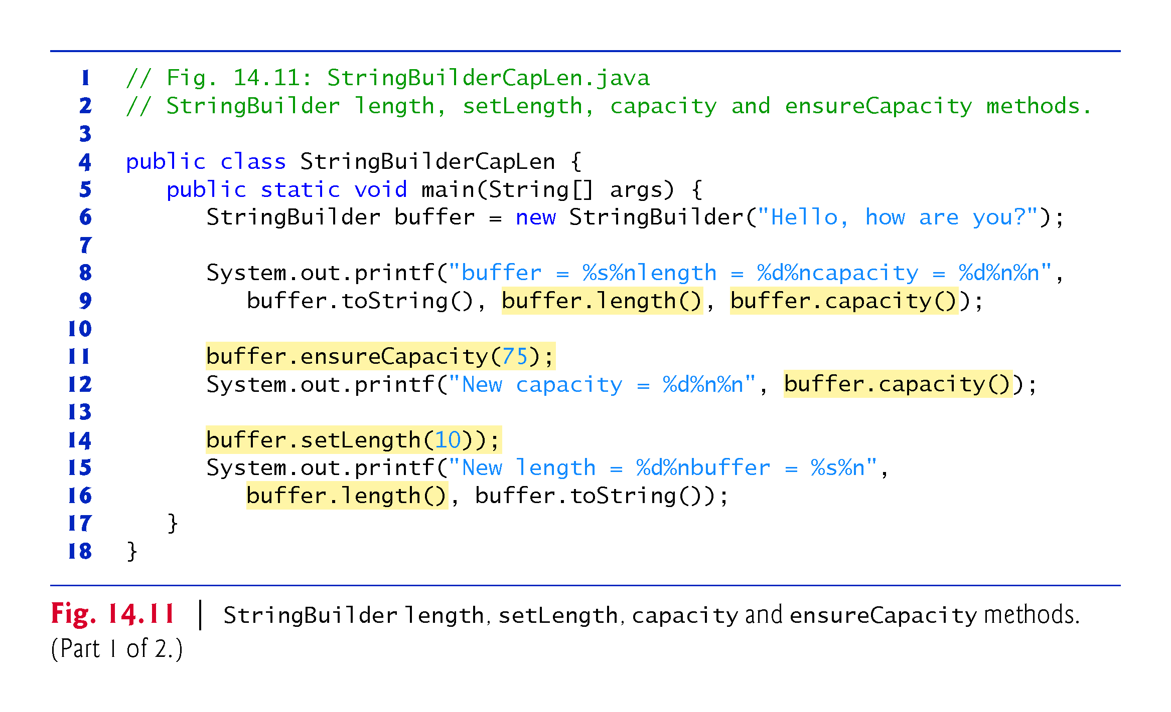

Slide 53
StringBuilder Methods
Method charAt:
takes an integer argument and returns the character in the StringBuilder at that index.
Method getChars:
copies characters from a StringBuilder into the character array argument.
Four arguments:
the starting index from which characters should be copied,
the index one past the last character to be copied,
the character array into which the characters are to be copied, and
the starting location in the character array where the first character should be placed.
CMPS 251 (Object-Oriented Programming), Mohammad Saleh, Spring 2015, CSE-CENG-QU

Slide 54
StringBuilder Methods
Method reverse:
reverses the contents of the StringBuilder.
Method setCharAt:
takes an integer and a character argument
sets the character at the specified position in the StringBuilder to the character argument.
CMPS 251 (Object-Oriented Programming), Mohammad Saleh, Spring 2015, CSE-CENG-QU

Slide 55
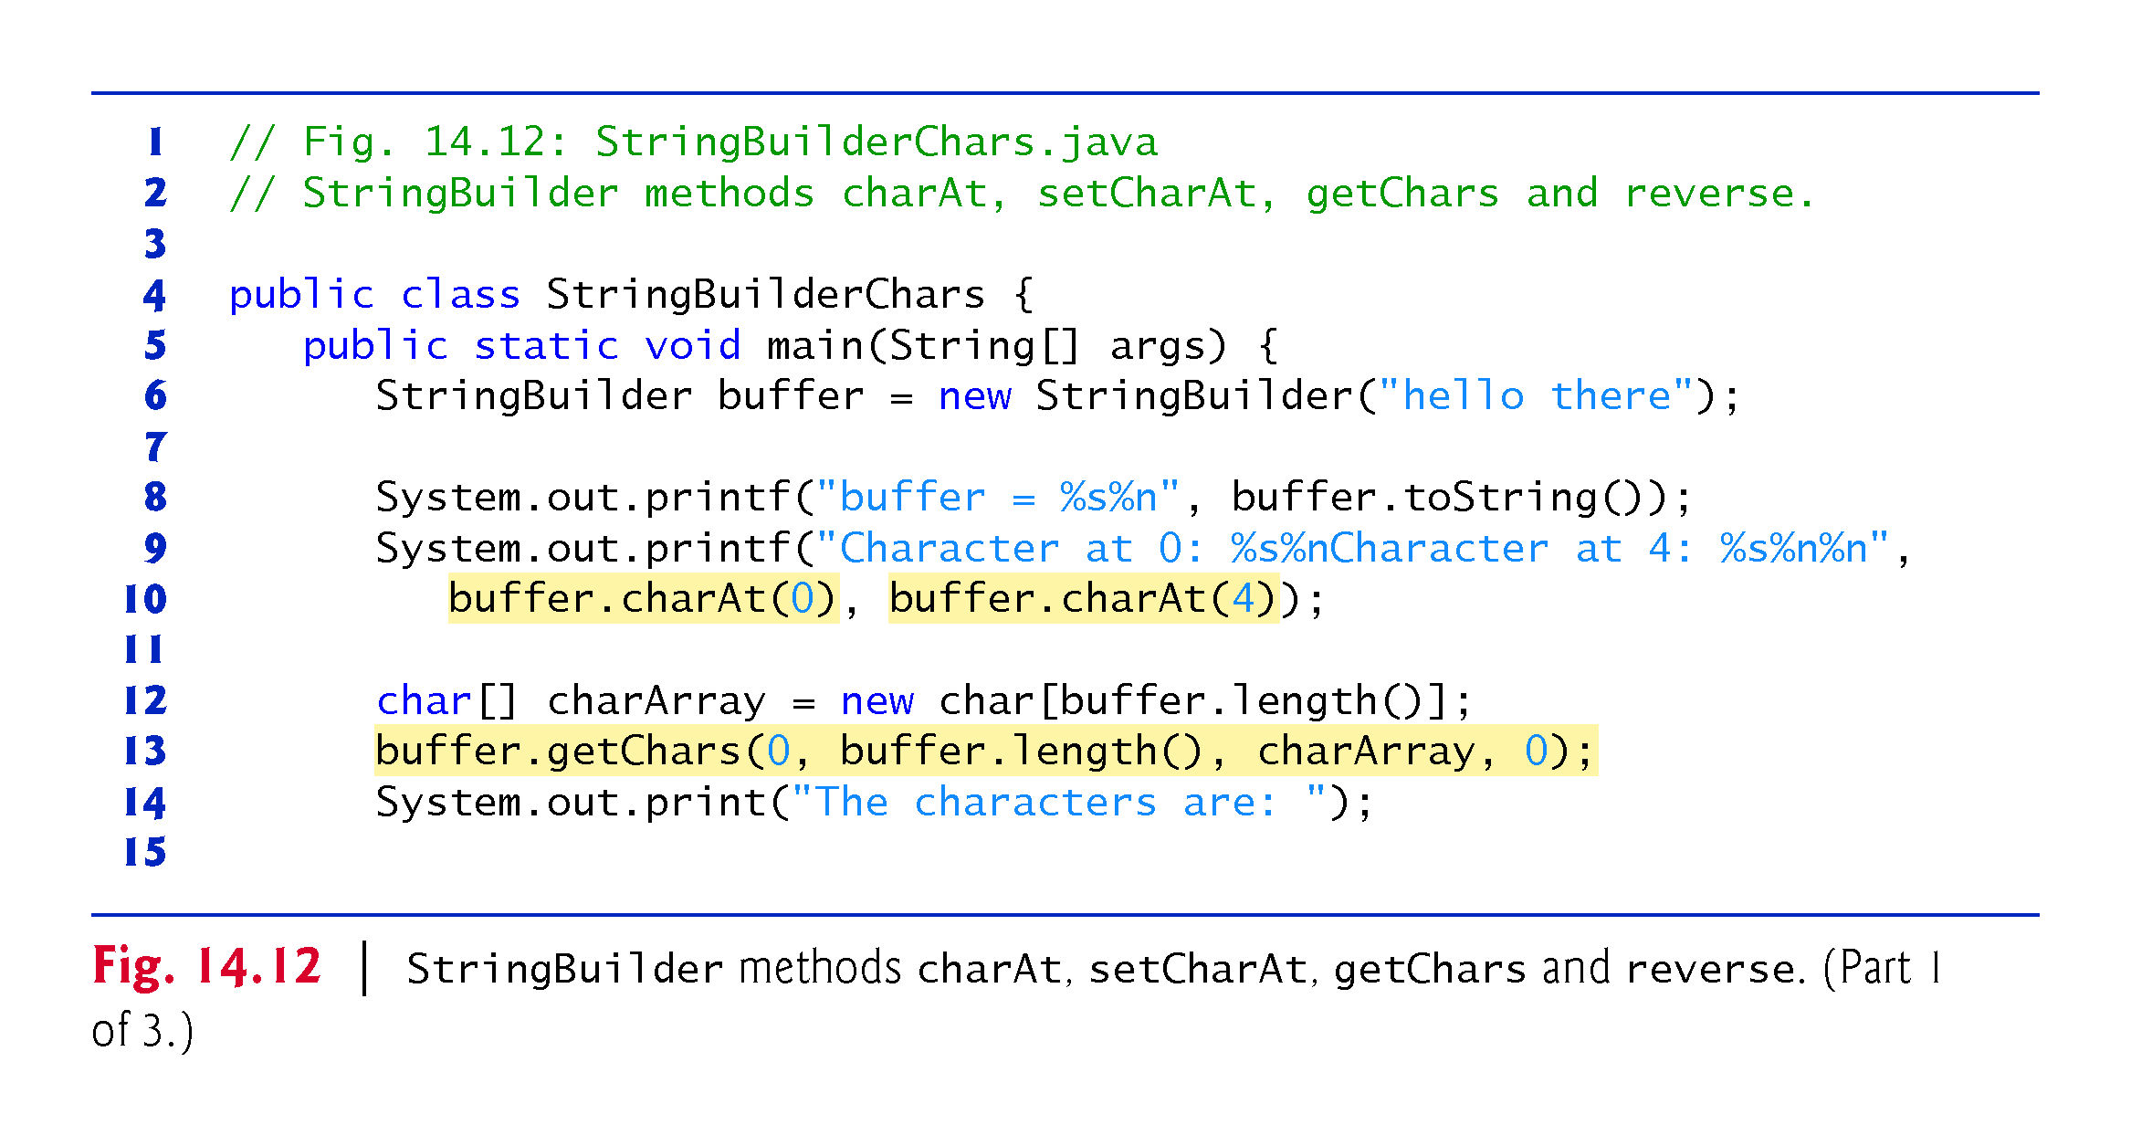

Slide 56
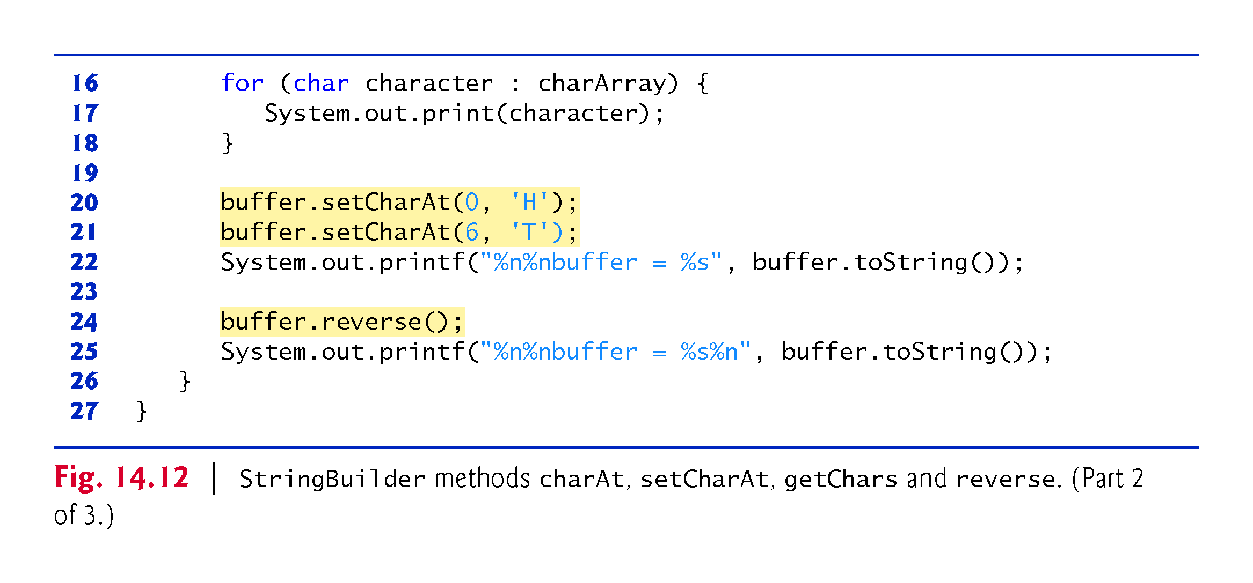

Slide 57
StringBuilder Methods
Overloaded append methods:
allow values of various types to be appended to the end of a StringBuilder.
Versions are provided for each of the primitive types, and for character arrays, Strings, Objects, and more.
A compiler can use StringBuilder and the append methods to implement the + and += String concatenation operators.
CMPS 251 (Object-Oriented Programming), Mohammad Saleh, Spring 2015, CSE-CENG-QU

Slide 58
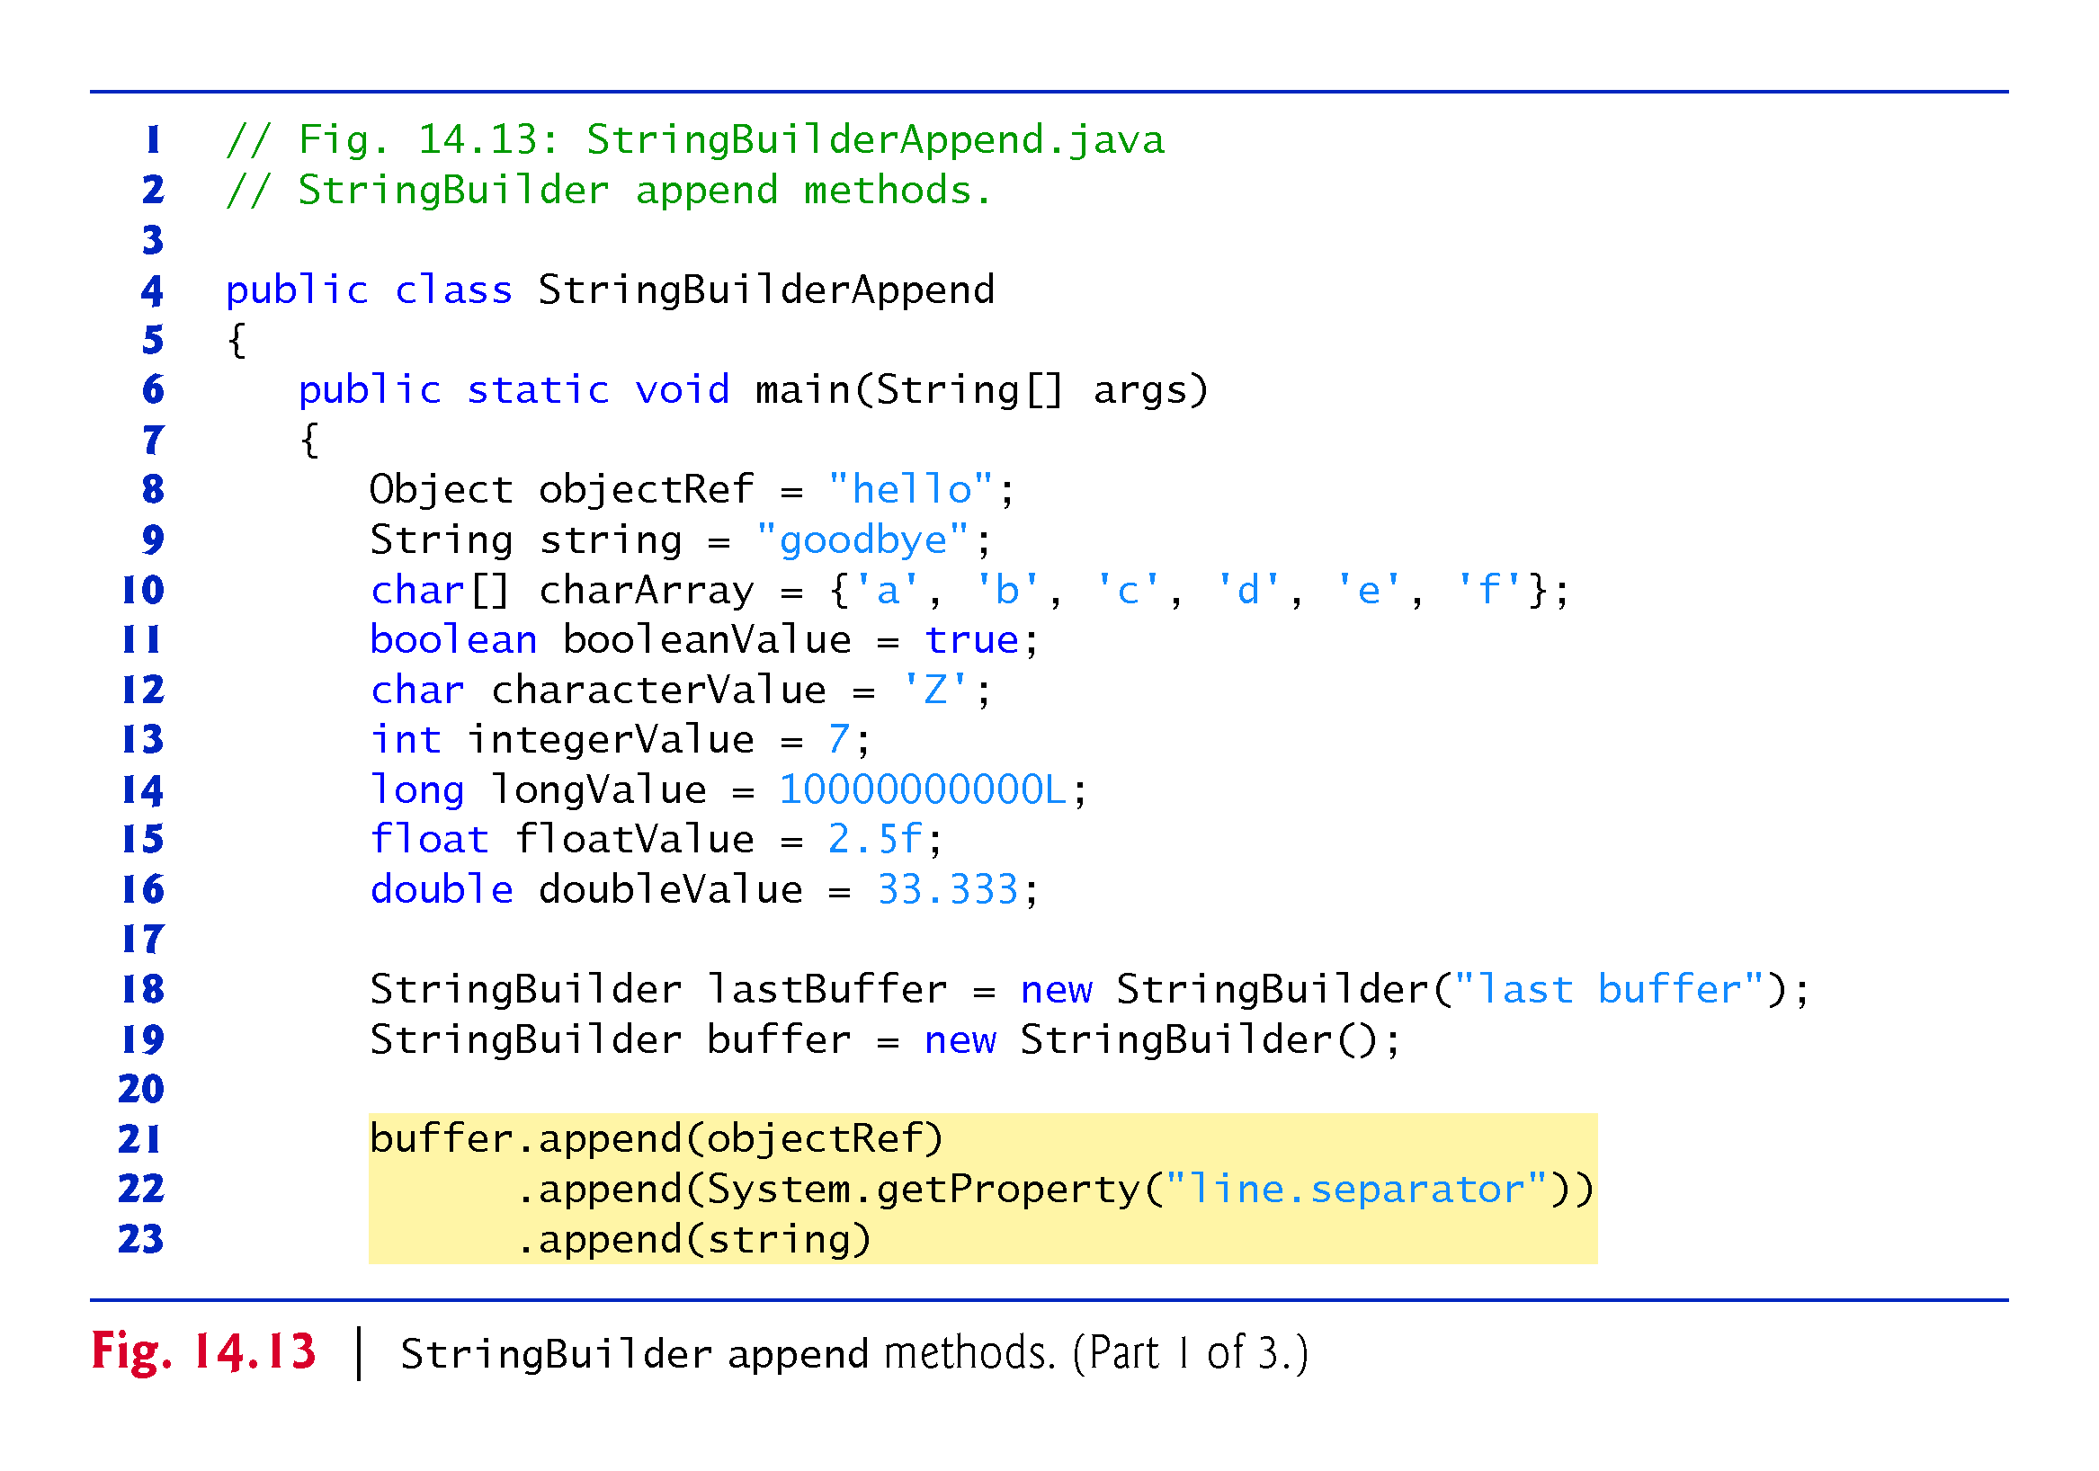

Slide 59
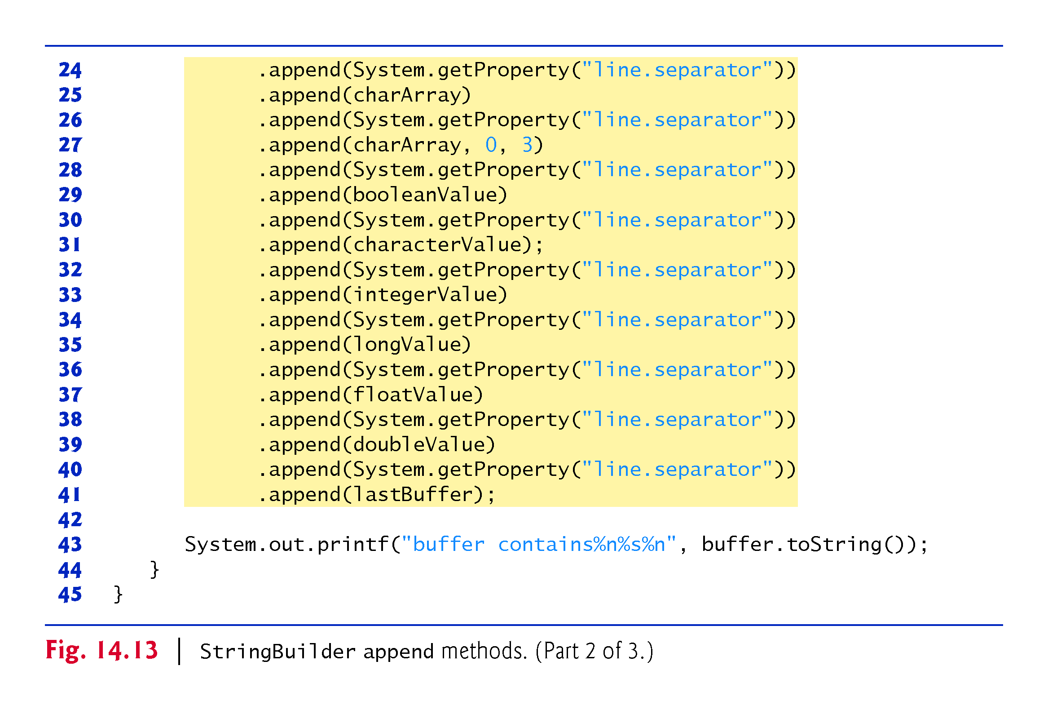

Slide 60
StringBuilder Methods
Overloaded insert methods:
insert values of various types at any position in a StringBuilder.
Versions are provided for the primitive types and for character arrays, Strings, Objects and CharSequences.
Each method takes its second argument, converts it to a String and inserts it at the index specified by the first argument.
Methods delete and deleteCharAt:
delete characters at any position in a StringBuilder.
Method delete takes two arguments:
the starting index and
the index one past the end of the characters to delete.
Method deleteCharAt takes one argument:
the index of the character to delete
CMPS 251 (Object-Oriented Programming), Mohammad Saleh, Spring 2015, CSE-CENG-QU

Slide 61
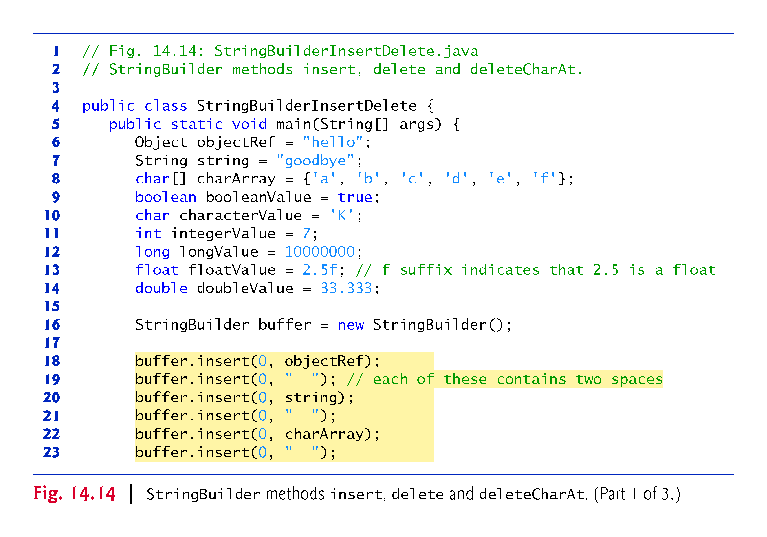

Slide 62
